Slide 1


International school of
programming for kids
Module 1. Lesson 1.
Review.
Exception handling
Link to guidelines

Slide 2

Module 1. Lesson 1. Review. Exception handling
Welcome
to ProTeam!

Slide 3
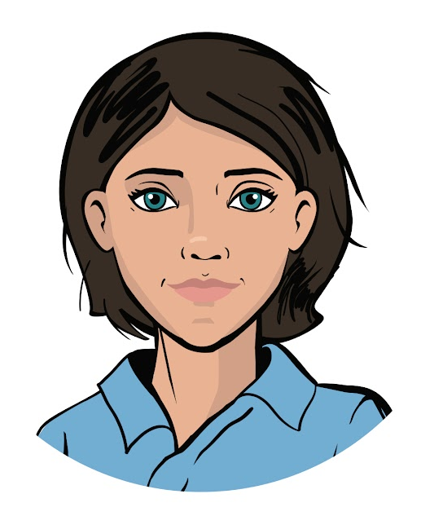

Congratulations on starting work at ProTeam!
My name is Emily and I am a project manager at ProTeam.
I do the following:
set tasks for employees and monitor their fulfillment;
teach the rules for working on projects;
transfer employees to new positions;
organize events.
Working at an
IT company
Emily,
project manager

Slide 4
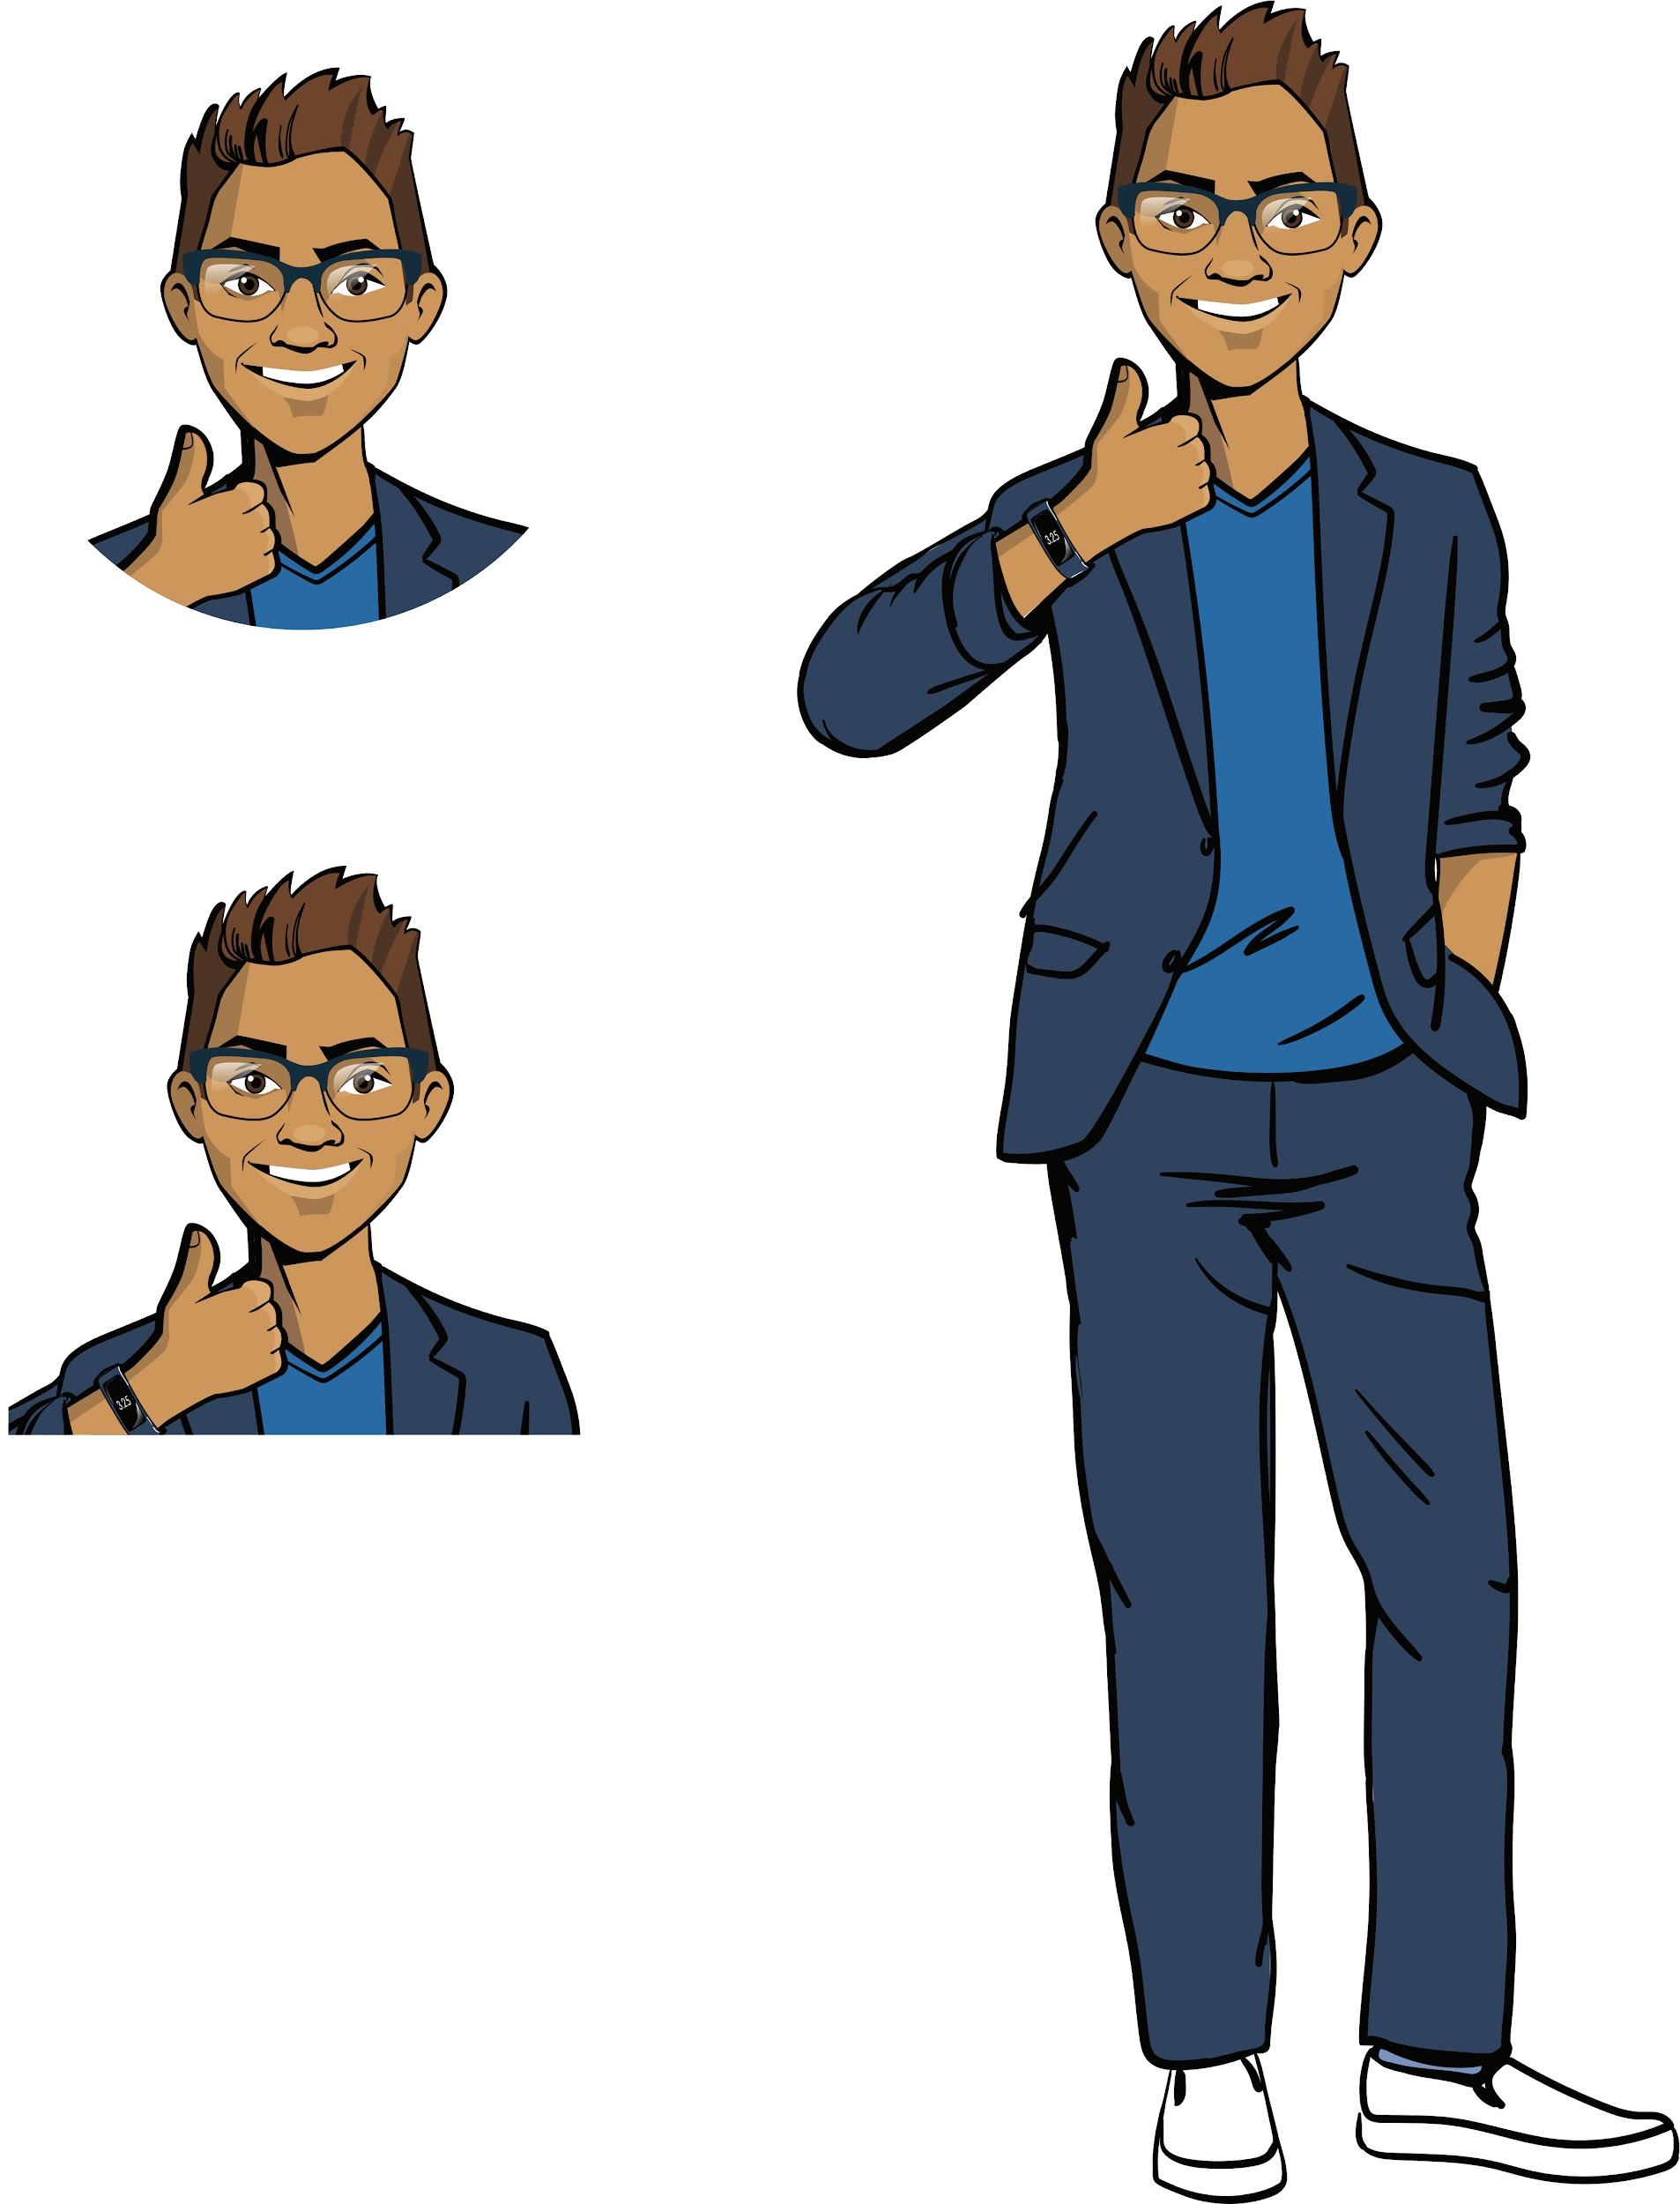
Congratulations on starting work at ProTeam!
My name is Cole and I am a senior python developer at ProTeam.
I do the following:
software and application development
in Python;
assess the quality of programs written by others;
assist interns.
We hope you will quickly feel at ease in the team
and be able to show what great developers you are!
Working at an
IT company
Cole,
senior developer

Slide 5
Module 1. Lesson 1. Review. Exception handling
Welcome back to ProTeam!

Slide 6
Welcome, developers!
We hope you haven’t forgotten about your mentors!
My name is Emily and I am a project manager at ProTeam.
I do the following:
set tasks for employees and monitor their fulfillment;
teach the rules for working on projects;
transfer employees to new positions;
organize events.
Discussing
work tasks
Emily,
project manager

Slide 7
Welcome, developers!
We hope you haven’t forgotten about your mentors!
My name is Cole and I am a senior python developer at ProTeam.
I do the following:
software and application development
in Python;
assess the quality of programs written by others;
assist other developers.
Discussing
work tasks
Cole,
senior developer

Slide 8
Welcome, developers!
Remember how many great orders we have already completed?
A smart file cabinet for the botanical garden
Our own functions and modules for the "Light" architectural bureau
Professional growth
Discussing
work tasks
Smart recommendations for the “Longevity” health food store
Automated feedback collection for the “Sunflowers” health center

Slide 9
Welcome, developers!
A description of several upcoming projects is already stored in the task manager:
Customer | Description
The "A’s for All" private school | A school knowledge base with information about academic performance, student records, etc.
Scientific Institute of Space Research | Application for smart notes with searching by tags.
The PlayForever game development studio | Create their own game library for interactive 2D novels.
Discussing
work tasks
And that’s just the beginning!

Slide 10
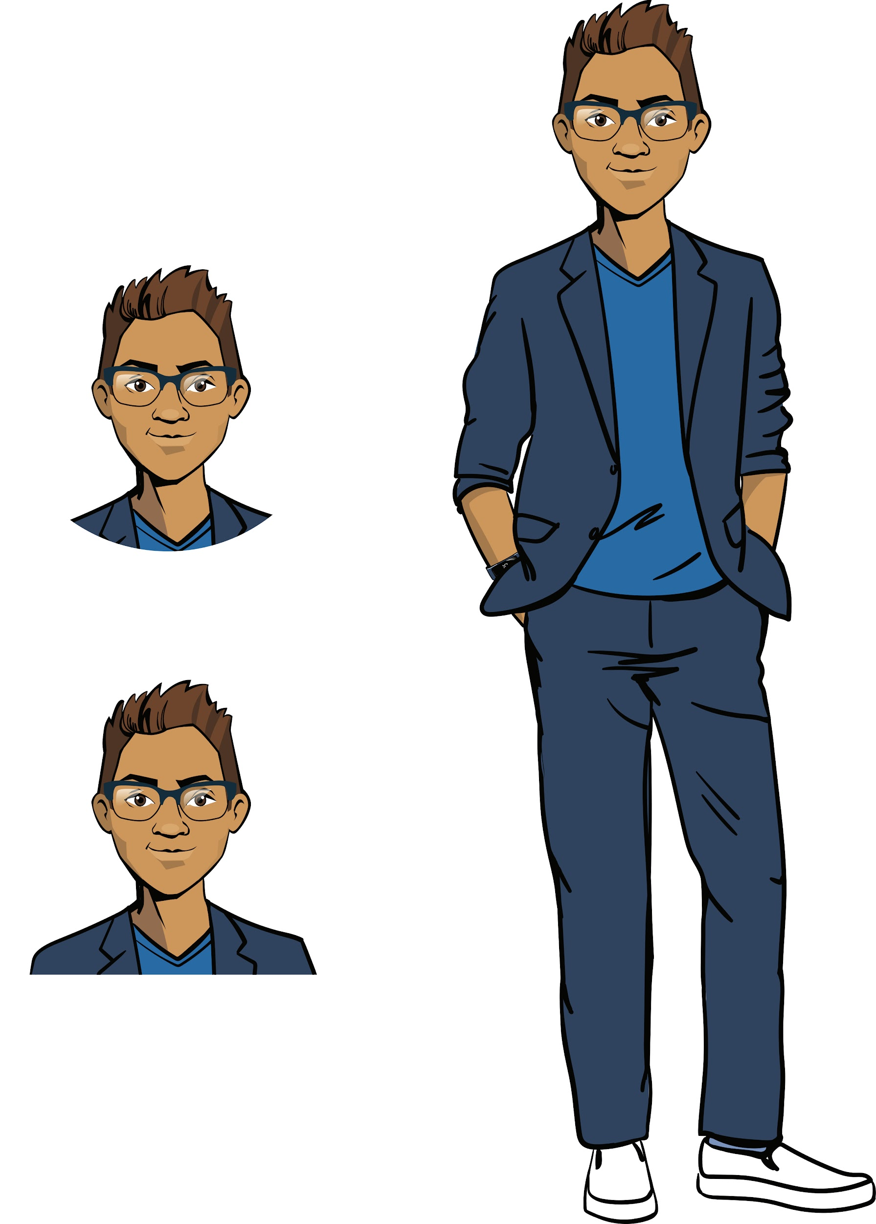
Welcome, developers!
Difficult but interesting work tasks await you.
In order to cope with everything and not let your customers down, you need to know not only the basic Python constructions, but some other developer tools as well.
Ready?
Discussing
work tasks
Cole,
senior developer

Slide 11
The goal of the work day is
to recall the basic tools in Python and apply them to program the first customer request.
Today you will
Discussing
work tasks
go through the qualifications for the Python developer position
program an automatic knowledge assessment system;
study the user notification tool about errors in the program.

Slide 12

Module 1. Lesson 1. Review. Exception handling
Qualifications

Slide 13
Show that you are ready for a brainstorming session!
Show your knowledge
of the programming language
after a long break.
Qualifications

Slide 14
What data types do you know?
Qualifications

Slide 15
What data types do you know?
We know four data types:
integers,
decimals,
float,
boolean.
Numbers |  | Strings | Boolean type
144 | Integer (int) | 'John' (str) | True (bool)
48.3 | Decimal (float) | '256'(str) | False (bool)
(2*11) | Integer (int) | '15.05.2007' (str) | 0 < 10 (bool)
(4*8.2) | Decimal (float) | 'Data received' (str) | name != John (bool)
Qualifications

Slide 16
What is a function? What input and output functions do you know?
Qualifications

Slide 17
A function is an algorithm compiled in a programming language that has a unique name.
Example (data input and output functions):
Function syntax | Purpose | Result
print ('Hello, hackers!') | Information output on the screen | Hello, hackers!
name = input(‘Your name:’) | Getting data from the keyboard and saving it to a variable | Your name: >>> Sam
Qualifications
Will be saved in name.

Slide 18
What is a conditional statement?
What is it used for?
Qualifications

Slide 19
A conditional statement
is a command that performs or does not perform an action depending on the value of the logical expression.
Usage example:
performing action A if the expression is true or action B if it is false.
Qualifications
Yes
Is the logical expression true?
No
Perform action A
Perform action B

Slide 20
What types of conditional statements do you know? What words are used to set them?
Qualifications

Slide 21
Types of conditional statements:
basic conditional statements;
nested conditional statements;
conditional statements with multiple branches.
BASIC:
The action block begins with a colon
:
if
Expression is true
:
if
Expression is true
Qualifications
Perform action 1
Perform action 1
else
Perform action 2
:
Perform action 3
Perform action 2
4 spaces
4 spaces

Slide 22
Types of conditional statements:
basic conditional statements;
nested conditional statements;
conditional statements with multiple branches.
NESTED:
if
:
If Expression_1 is true,
And if Expression_2 is true,
Perform action_1
In all other cases,
Perform action 2.
(In the end)
Perform action 3
Expression_1 is true
if
:
Qualifications
Expression_2 is true
Perform action 1
else
:
Perform action 2
Perform action 3

Slide 23
Types of conditional statements:
basic conditional statements;
nested conditional statements;
conditional statements with multiple branches.
OPERATOR WITH MULTIPLE BRANCHES:
if
Expression_1 is true
:
If Expression_1 is true,
Perform action 1.
Otherwise, if Expression_2 is true,
Perform action 2.
In all other cases,
Perform action 3.
Qualifications
Perform action 1
elif
Expression_2 is true
:
Perform action 2
else
:
Perform action 3

Slide 24
What is a loop?
What is it used for?
Qualifications

Slide 25
A loop
is a command that performs the indicated actions as long as the logical expression (condition) remains true.
Example:
The loop performs action A as long as the logical expression is true
Qualifications
Is the logical expression true?
Yes
No
Perform action A

Slide 26
What types of loops do you know? What words are used to set them?
Qualifications

Slide 27
The while loop:
basic loop;
loop with a counter.
BASIC:
while
abc < 3
:
Qualifications
Perform action 1
Perform action 2
Perform action 3

Slide 28
The while loop:
basic loop;
loop with a counter.
LOOP WITH A COUNTER:
Create a counter variable and set the initial value to 0
While Expression is true,
Perform action 1,
Perform action 2.
Increase the value of the counter to 1
i = 0
while
i < 10
:
Qualifications
Perform action 1
Perform action 2
i += 1
*The counter can be used to count loop repeats.

Slide 29
Qualifications confirmed!
Great, you are ready for brainstorming and completing your work tasks!
Qualifications

Slide 30

Module 1. Lesson 1. Review. Exception handling
Brainstorming:
The “A’s for All”
private school

Slide 31
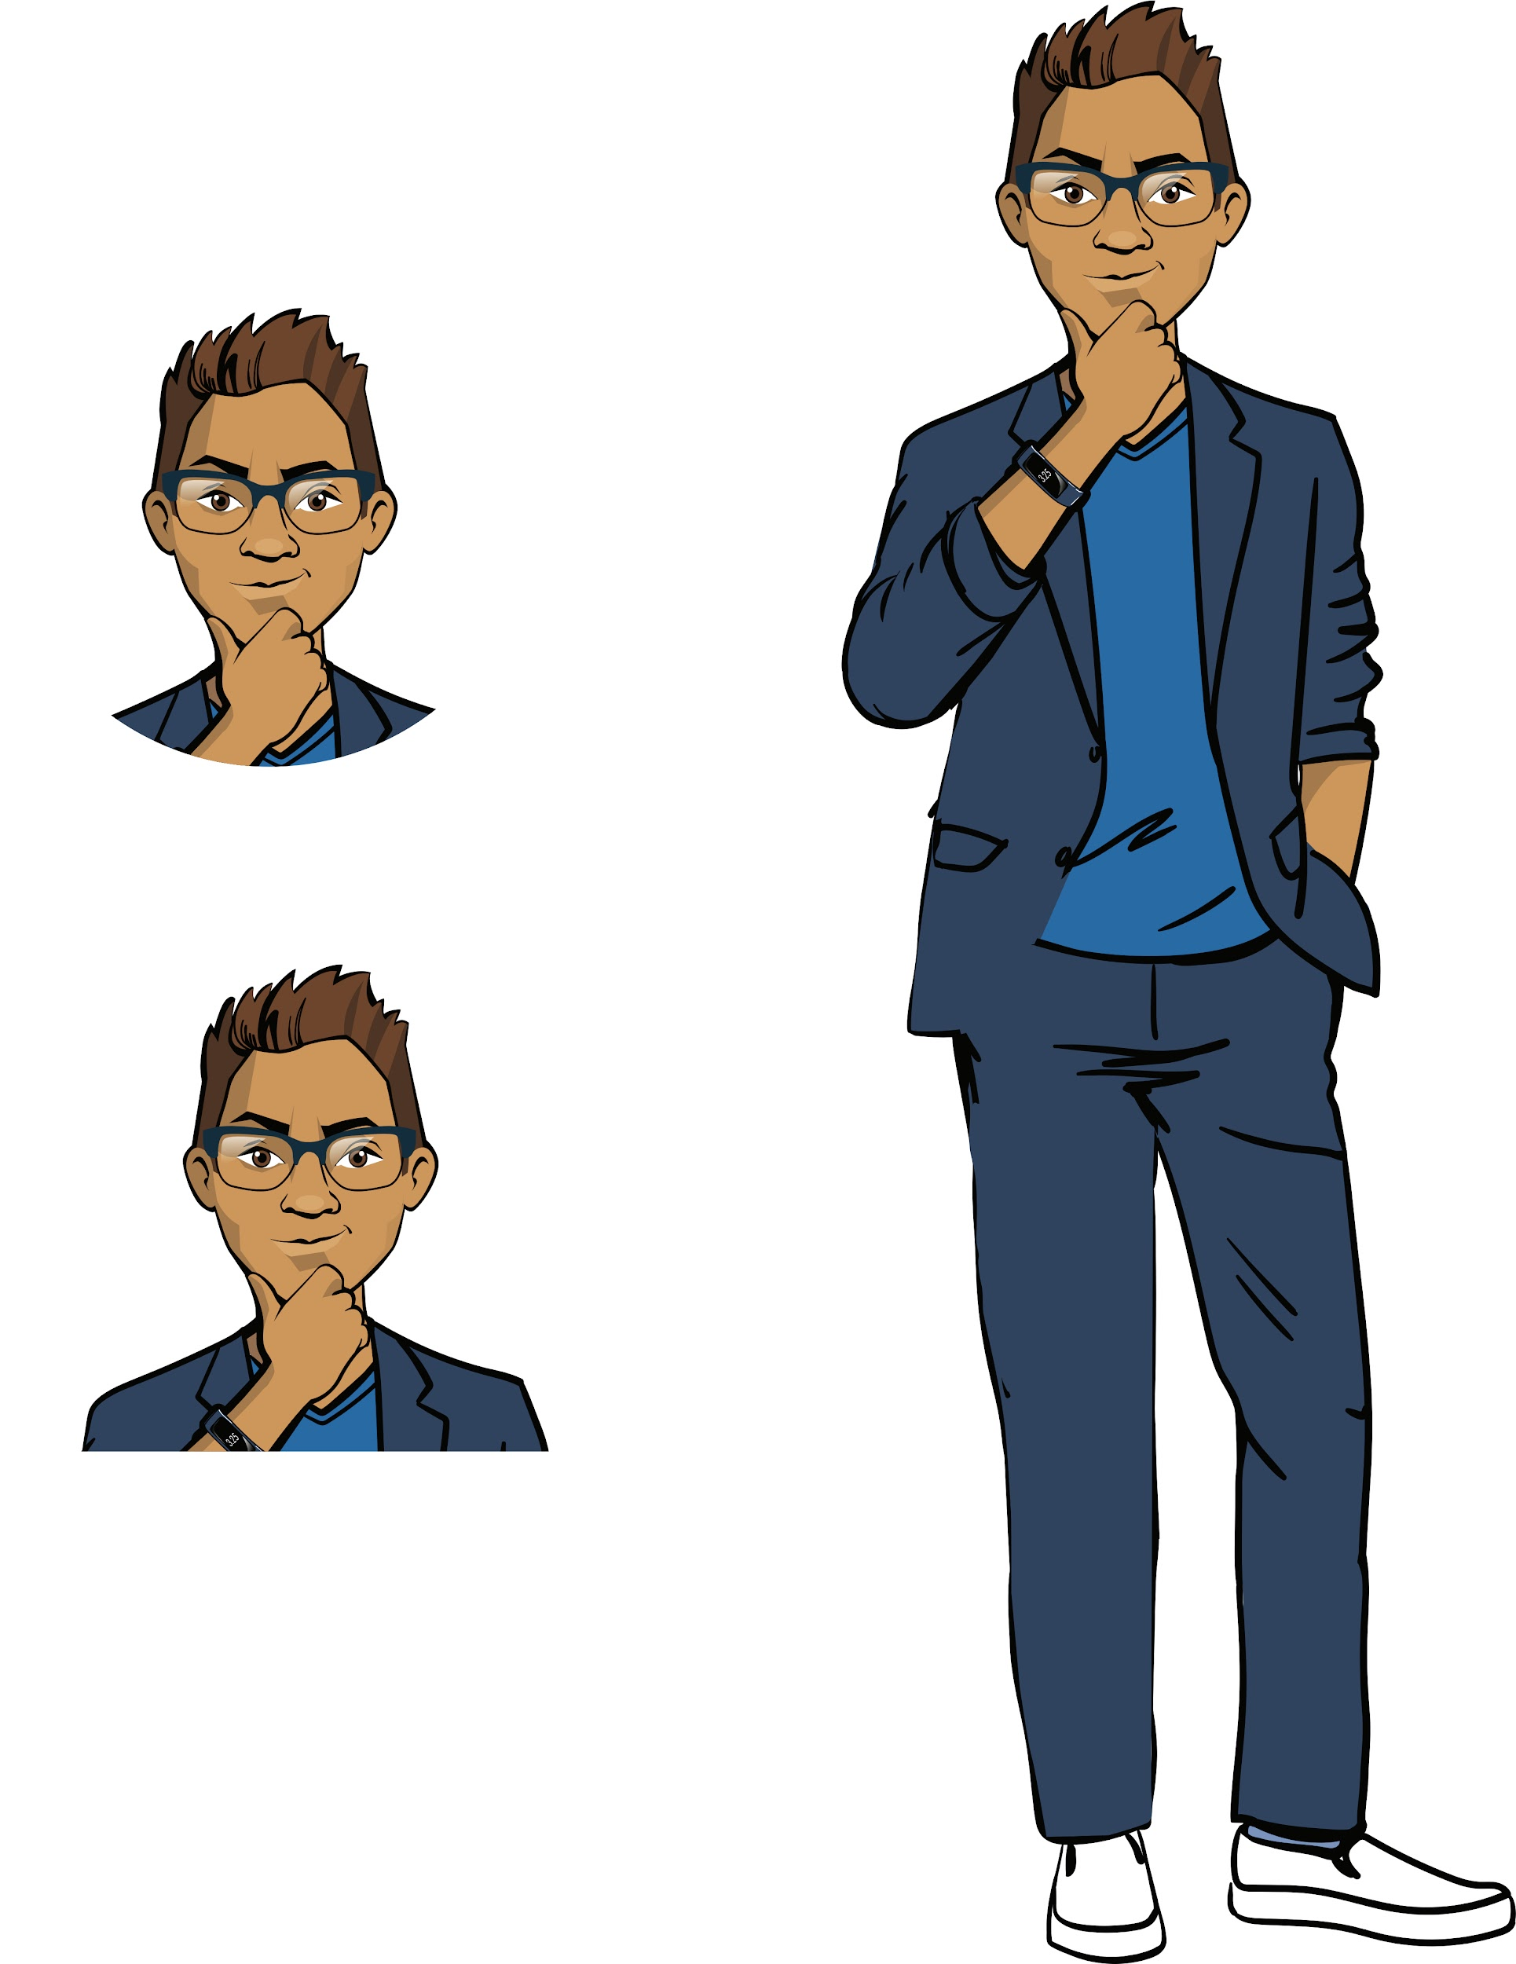
Request from the school’s director
The director of the “A’s for All” school contacted ProTeam.
Every quarter, their elementary school students undergo mandatory testing to assess their performance.
It’s hard for teachers to check a large number of tests, so the school’s leadership decided to order a set of programs from ProTeam for automatic testing of students.
Brainstorming

Slide 32
Planning work tasks
The students’ knowledge is assessed using test questions.
The questions can be of different types, for example:
choose the correct answer from four possible answers (multiple choice);
free answer (no options).
Let’s look at a few tasks sent by teachers.
Brainstorming

Slide 33
Planning work tasks
The task. Write a program that displays a question and answer options. Then the student is asked to enter a response and the result is displayed.
"Which tree is not coniferous: pine, cedar, spruce, maple".
Brainstorming
How will this program work?

Slide 34
Planning work tasks
The task. Write a program that displays a question and answer options. Then the student is asked to enter a response and the result is displayed.
"Which tree is not coniferous: pine, cedar, spruce, maple".
Display the question and answer options
Enter the student’s response
Brainstorming
Was the student’s answer Maple?
Yes
No
Output: “That’s right”
Output: “Incorrect answer”

Slide 35
Planning work tasks
The task. Write a program that displays a question and answer options. Then the student is asked to enter a response and the result is displayed.
"Which tree is not coniferous: pine, cedar, spruce, maple".
We will need the following:
Data input-output —
the print() and input() functions.
To determine if the response is correct — the conditional statement if — else.
Brainstorming

Slide 36
Planning work tasks
The task. Write a program that displays a question and answer options. Then the student is asked to enter a response and the result is displayed.
"Which tree is not coniferous: pine, cedar, spruce, maple".
print('Which tree is not coniferous: pine, cedar, spruce, maple')
answer = input('Ответ:')
if answer == 'клён':
print('Абсолютно верно!')
else:
print('Ответ неверный')
?
Brainstorming

Slide 37
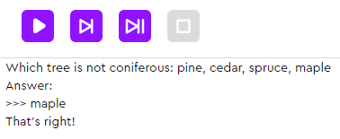
Planning work tasks
The task. Write a program that displays a question and answer options. Then the student is asked to enter a response and the result is displayed.
"Which tree is not coniferous: pine, cedar, spruce, maple".
print('Which tree is not coniferous: pine, cedar, spruce, maple')
answer = input('Answer:')
if answer == 'maple':
print('That’s right!')
else:
print('Incorrect answer')
Brainstorming

Slide 38
Planning work tasks
The task. Write a program that asks a question with a free answer. If the answer is incorrect, the program displays "Try again!" and the question is asked again. If the answer is correct, the program displays “That’s right!” and shuts down.
"A square is given with a side of 3. What is its perimeter?"
Brainstorming
How will this program work?

Slide 39
Planning work tasks
The task. Write a program that asks a question with a free answer. If the answer is incorrect, the program displays "Try again!" and the question is asked again. If the answer is correct, the program displays “That’s right!” and shuts down.
"A square is given with a side of 3. What is its perimeter?"
Question output
Answer input
Brainstorming
Answer other than 12?
No
Yes
“Try again!”
Answer input
“That’s right!”

Slide 40
Planning work tasks
The task. Write a program that asks a question with a free answer. If the answer is incorrect, the program displays "Try again!" and the question is asked again. If the answer is correct, the program displays “That’s right!” and shuts down.
"A square is given with a side of 3. What is its perimeter?"
We will need the following:
Data input-output —
the print() and input() functions.
To transition to the integer data type — the int() function.
To repeat the steps until the correct answer is given — the while loop.
Brainstorming

Slide 41
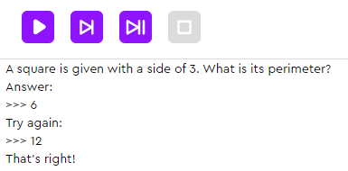
Planning work tasks
The task. Write a program that asks a question with a free answer. If the answer is incorrect, the program displays "Try again!" and the question is asked again. If the answer is correct, the program displays “That’s right!” and shuts down.
"A square is given with a side of 3. What is its perimeter?"
print('A square is given with a side of 3. What is its perimeter?')
answer = int(input('Answer:'))
while answer != 12:
answer = int(input('Try again:'))
print('That’s right!')
Brainstorming

Slide 42
Planning work tasks
The task. Write a program that asks a question with a free answer. If the answer is incorrect, the program displays "Try again!" and the question is asked again. If the answer is correct, the program displays “That’s right!” and shuts down.
"A square is given with a side of 3. What is its perimeter?"
print('A square is given with a side of 3. What is its perimeter?')
answer = int(input('Answer:'))
while answer != 12:
answer = int(input('Try again:'))
print('That’s right!')
Brainstorming
How can we modify the program so that it displays the number of attempts made?

Slide 43
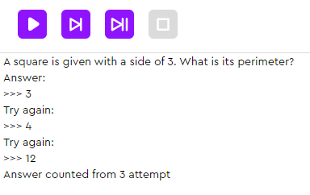
Possible modification:
Question output
Answer input
Add a counter for the number of responses.
i = 1
Answer other than 12?
No
Yes
“Try again!”
Brainstorming
Question output
i = i + 1
“Answer counted from attempt”, i

Slide 44
Planning work tasks
The task. Write a program that asks a question with a free answer. If the answer is incorrect, the program displays "Try again!" and the question is asked again. If the answer is correct, the program displays “That’s right!” and shuts down.
"A square is given with a side of 3. What is its perimeter?"
print('A square is given with a side of 3. What is its perimeter?')
answer = int(input('Answer:'))
i = 1
while answer != 12:
answer = int(input('Try again:'))
i = i + 1 (i+=1)
print('Answer counted from', i, 'attempt')
Brainstorming

Slide 45
Before proceeding to the tasks:
What will the previous program display if the student enters: 12? 24?
How can we program improvement: if the student answers correctly on the first try, the program displays: “Get your A grade for paying attention!”
How can we program a question with three free answer attempts?
A four-answer-choice question is given.
How should the program respond if
the student enters an answer that does not match
any of the options?
Brainstorming

Slide 46
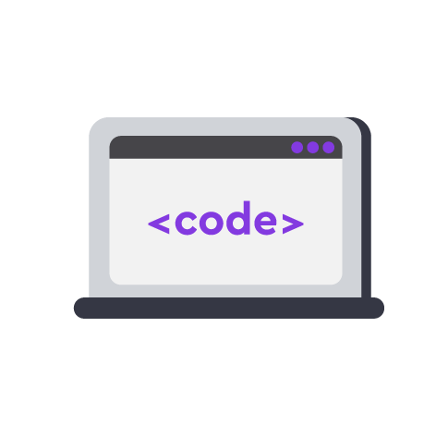
Module 1. Lesson 1. Review. Exception handling
“A’s for All”:
Knowledge check

Slide 47



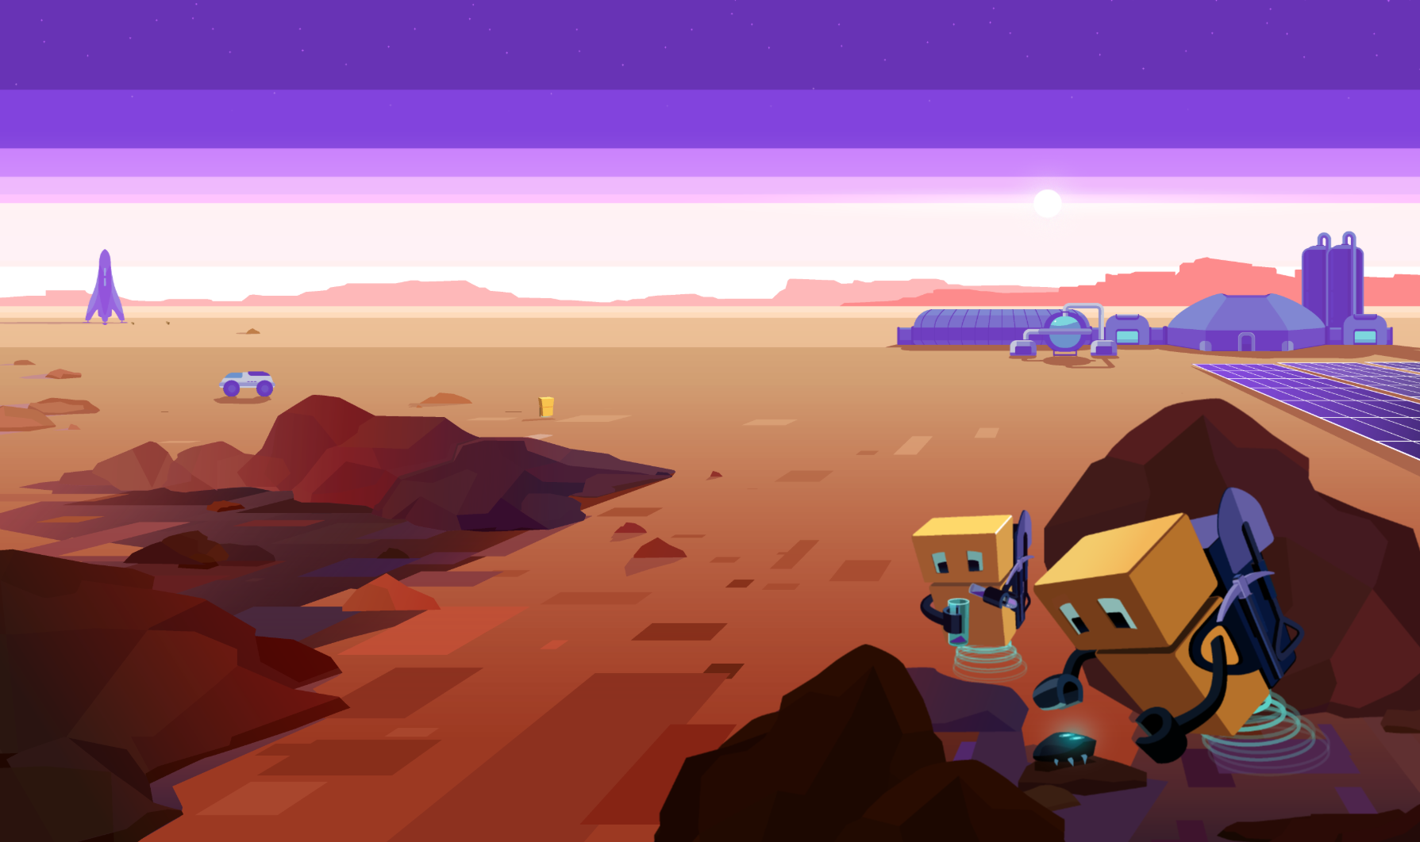
Complete tasks on the platform
A’s for All: check
mars.alg.academy
A’s for All:
Knowledge check

Slide 48

Break

Slide 49
Module 1. Lesson 1. Review. Exception handling
A’s for All:
Exception
handling

Slide 50
Let’s look at the task
The task. Write a program that checks the formula for calculating the area of a rectangle. There is one answer attempt. The user enters the lengths of the two sides of a rectangle. The program should display its area.
Brainstorming
It seems like we have already solved a similar task. What will the program look like?

Slide 51
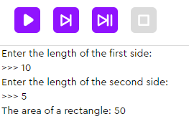
Let’s look at the task
The task. Write a program that checks the formula for calculating the area of a rectangle. There is one answer attempt. The user enters the lengths of the two sides of a rectangle. The program should display its area.
Possible solution:
a = int(input('Enter the length of the first side:'))
b = int(input('Enter the length of the second side:'))
s = a * b
print('The area of a rectangle:', s)
Brainstorming

Slide 52
Let’s look at the task
The task. Write a program that checks the formula for calculating the area of a rectangle. There is one answer attempt. The user enters the lengths of the two sides of a rectangle. The program should display its area.
Possible solution:
a = int(input('Enter the length of the first side:'))
b = int(input('Enter the length of the second side:'))
s = a * b
print('The area of a rectangle:', s)
Brainstorming
Hmm, this program won’t always work correctly.
In what cases?

Slide 53
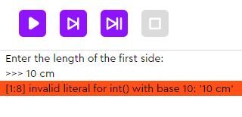
Let’s look at the task
The task. Write a program that checks the formula for calculating the area of a rectangle. There is one answer attempt. The user enters the lengths of the two sides of a rectangle. The program should display its area.
Possible solution:
a = int(input('Enter the length of the first side:'))
b = int(input('Enter the length of the second side:'))
s = a * b
print('The area of the rectangle:', s)
Brainstorming
A string with letters and numbers cannot be converted to an integer type.
What can we do?

Slide 54
We note the following:
The last time the program ran, the Python interpreter did not notice the error!
A user without programming skills will not understand the cause of this error and will not be able to use the program.
Brainstorming
We need a tool to detect unwanted program behavior and correctly notify the user of the cause of the error.

Slide 55
Exception handling
is identifying undesirable program behavior and describing the program’s reaction to that error.
Brainstorming
Based on the previous task, what kind of errors can be detected and corrected by an exception handler?

Slide 56
Exception handling
is identifying undesirable program behavior and describing the program’s reaction to that error.
Types of programming errors:
critical (detected by the interpreter and corrected by programmers);
hidden (not visible to the interpreter and they hinder the user).
Brainstorming
They can be recognized by the handler and a fix can be suggested.

Slide 57
Exception handling
is identifying undesirable program behavior and describing the program’s reaction to that error.
Getting potentially problematic data
try:
except:
Try to perform:
Action
If it doesn’t work out:
Action-reaction
Brainstorming
Attempt to perform an action with the data
Action-reaction if an error occurs

Slide 58
Let's modify the task
The task. Write a program that checks the formula for calculating the area of a rectangle. There is one answer attempt. The user enters the lengths of the two sides of a rectangle. The program should display its area.
a = int(input('Enter the length of the first side:'))
b = int(input('Enter the length of the second side:'))
s = a * b
print('The area of the rectangle:', s)
Brainstorming
How can we improve the program with exception handling?

Slide 59
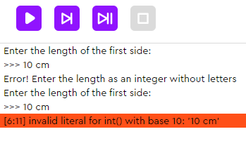
Let's modify the task
a = input('Enter the length of the first side:')
try:
a = int(a)
except:
print('Error! Enter the length as an integer without letters')
a = int(input('Enter the length of the first side:'))
b = input('Enter the length of the second side:')
try:
b = int(b)
except:
print('Error! Enter the length as an integer without letters')
b = int(input('Enter the length of the second side:'))
s = a * b
print('The area of the rectangle:', s)
Error again!
How can we anticipate that too?
Brainstorming

Slide 60
Let's modify the task
while True:
a = input('Enter the length of the first side:')
try:
a = int(a)
break
except:
print('Error! Enter the length as an integer without letters')
while True:
b = input('Enter the length of the second side:')
try:
b = int(b)
break
except:
print('Error! Enter the length as an integer without letters')
s = a * b
print('The area of the rectangle:', s)
We make the input of the length endless until it is received in the desired format.
Brainstorming

Slide 61
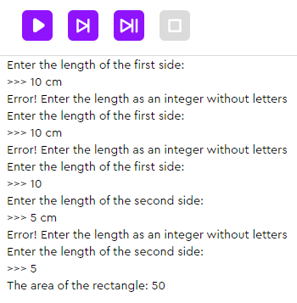
Let's modify the task
while True:
a = input('Enter the length of the first side:')
try:
a = int(a)
break
except:
print('Error! Enter the length as an integer without letters')
while True:
b = input('Enter the length of the second side:')
try:
b = int(b)
break
except:
print('Error! Enter the length as an integer without letters')
s = a * b
print('The area of the rectangle:', s)
Brainstorming

Slide 62
Conclusions:
An exception handler detects undesirable program behavior and describes the reaction to that error.
To program exception handling, we use the try and except operators.
If necessary, exception handling can be put into a loop.
Brainstorming

Slide 63
Module 1. Lesson 1. Review. Exception handling
“A’s for All:
Check 2

Slide 64
Complete tasks on the platform
A’s for All: check 2
mars.alg.academy
Sunflowers:
Feedback

Slide 65

Module 1. Lesson 1. Review. Exception handling
End of the
work day

Slide 66

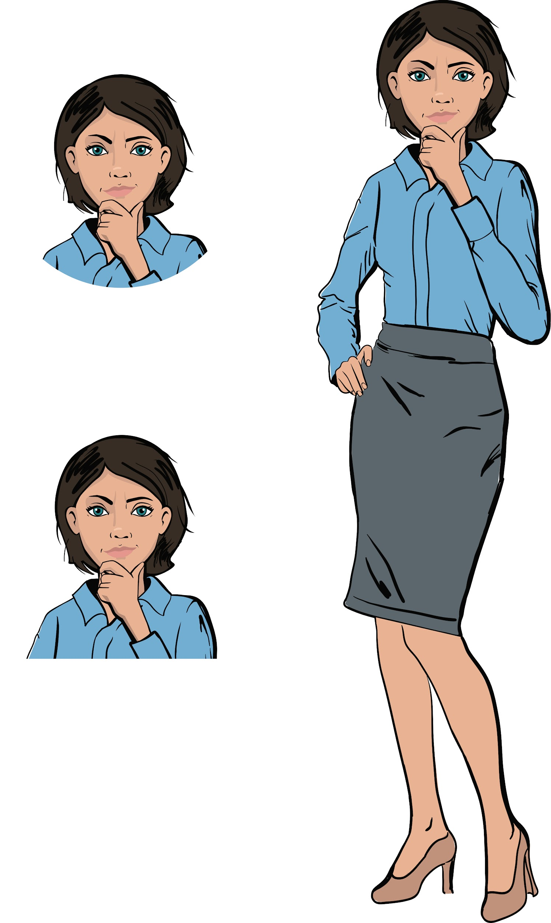
Let’s end the work day by
answering these technical questions
What algorithmic constructs do you know? What operators are they set by?
What is exception handling? What is it used for?
Summing up
the work day
Cole,
senior developer
Emily,
project manager

Slide 67
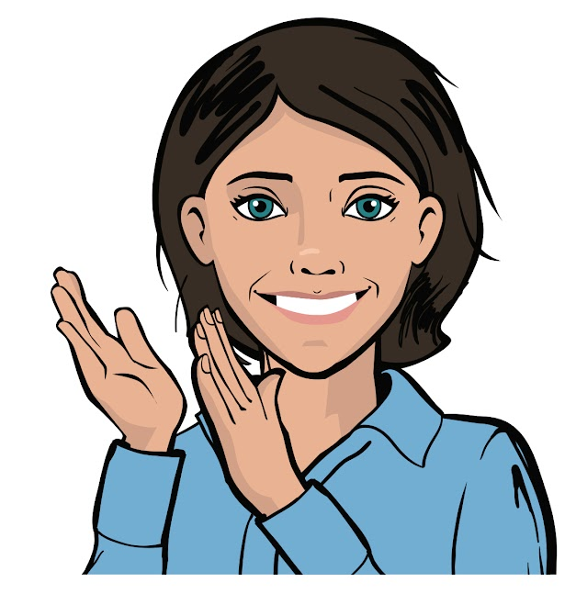
Congratulations on completing the work day!
Today you did the following:
went through skills qualifications;
programmed a knowledge assessment system;
learned and implemented an error detection tool.
Summing up
the work day

Slide 68
Evaluating your performance
Answer these questions with your colleagues:
What turned out the best?
What didn’t turn out the way you wanted?
What should you do next time
to avoid any issues?
Summing up
the work day

Slide 69
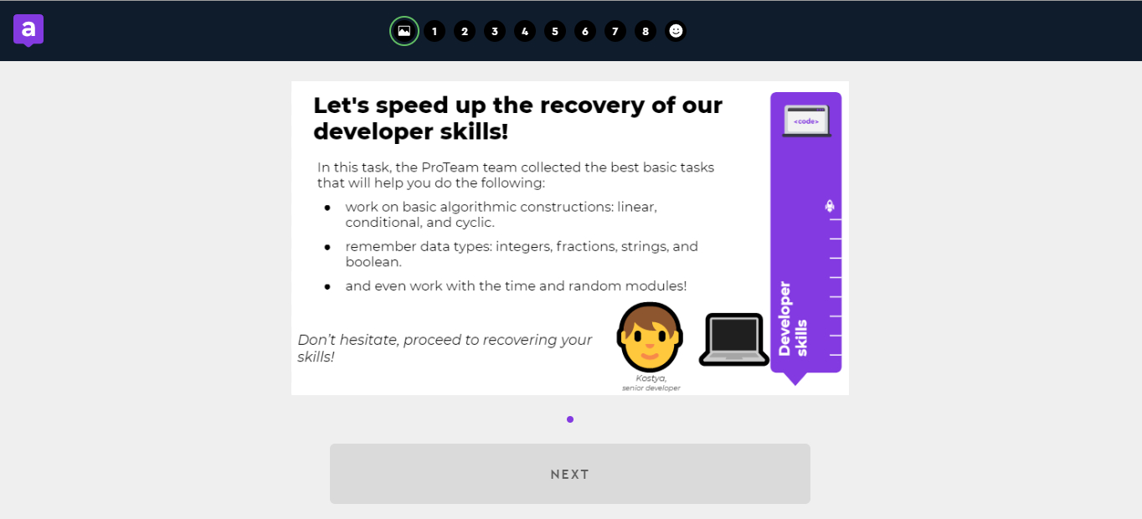
Additional tasks to improve your performance
“Developer skills. Tasks"
Summing up
the work day
Cole,
senior developer

Slide 70
Share projects with other students
Hall of Fame

Slide 71
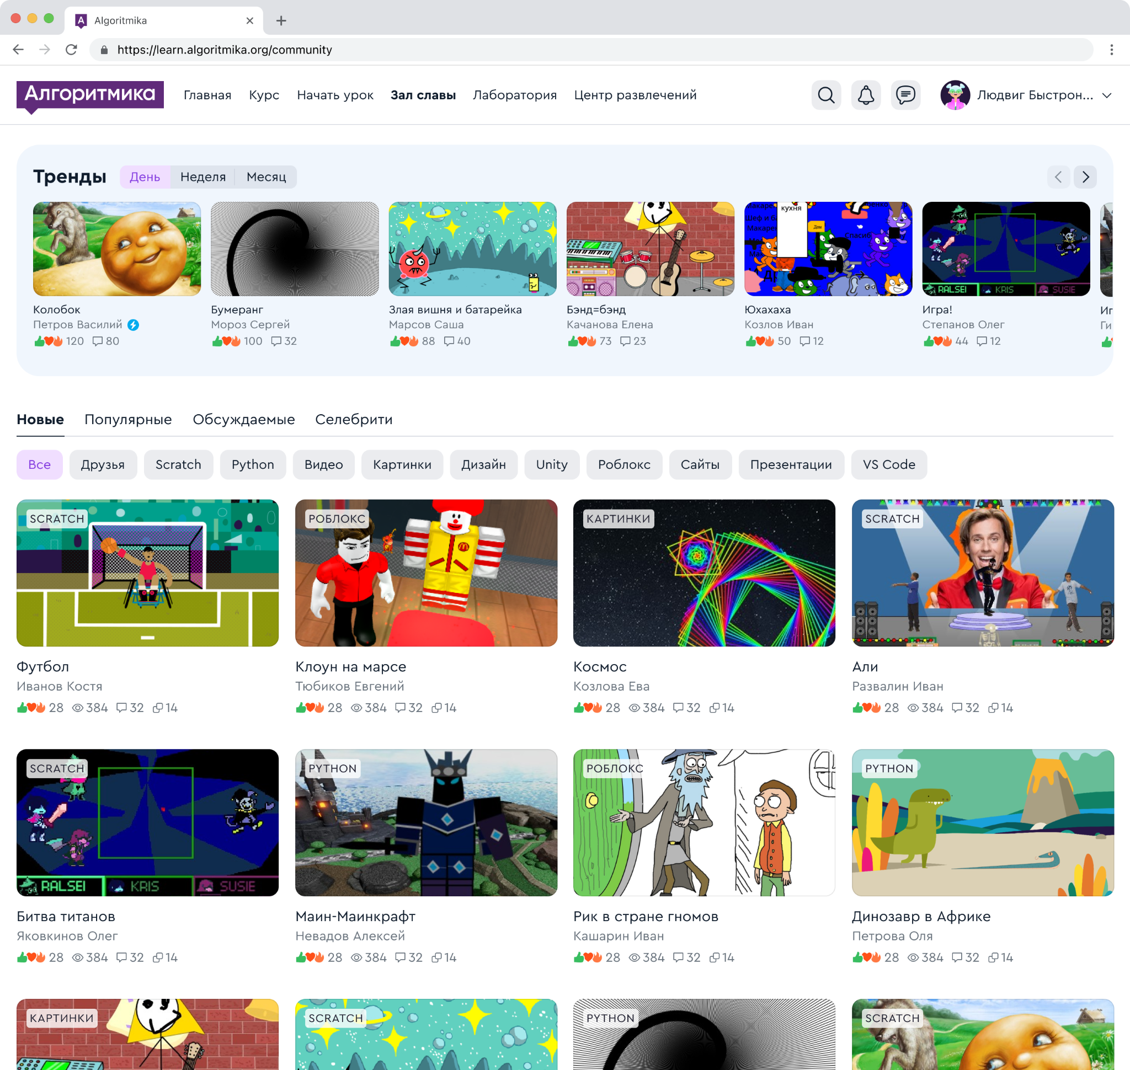
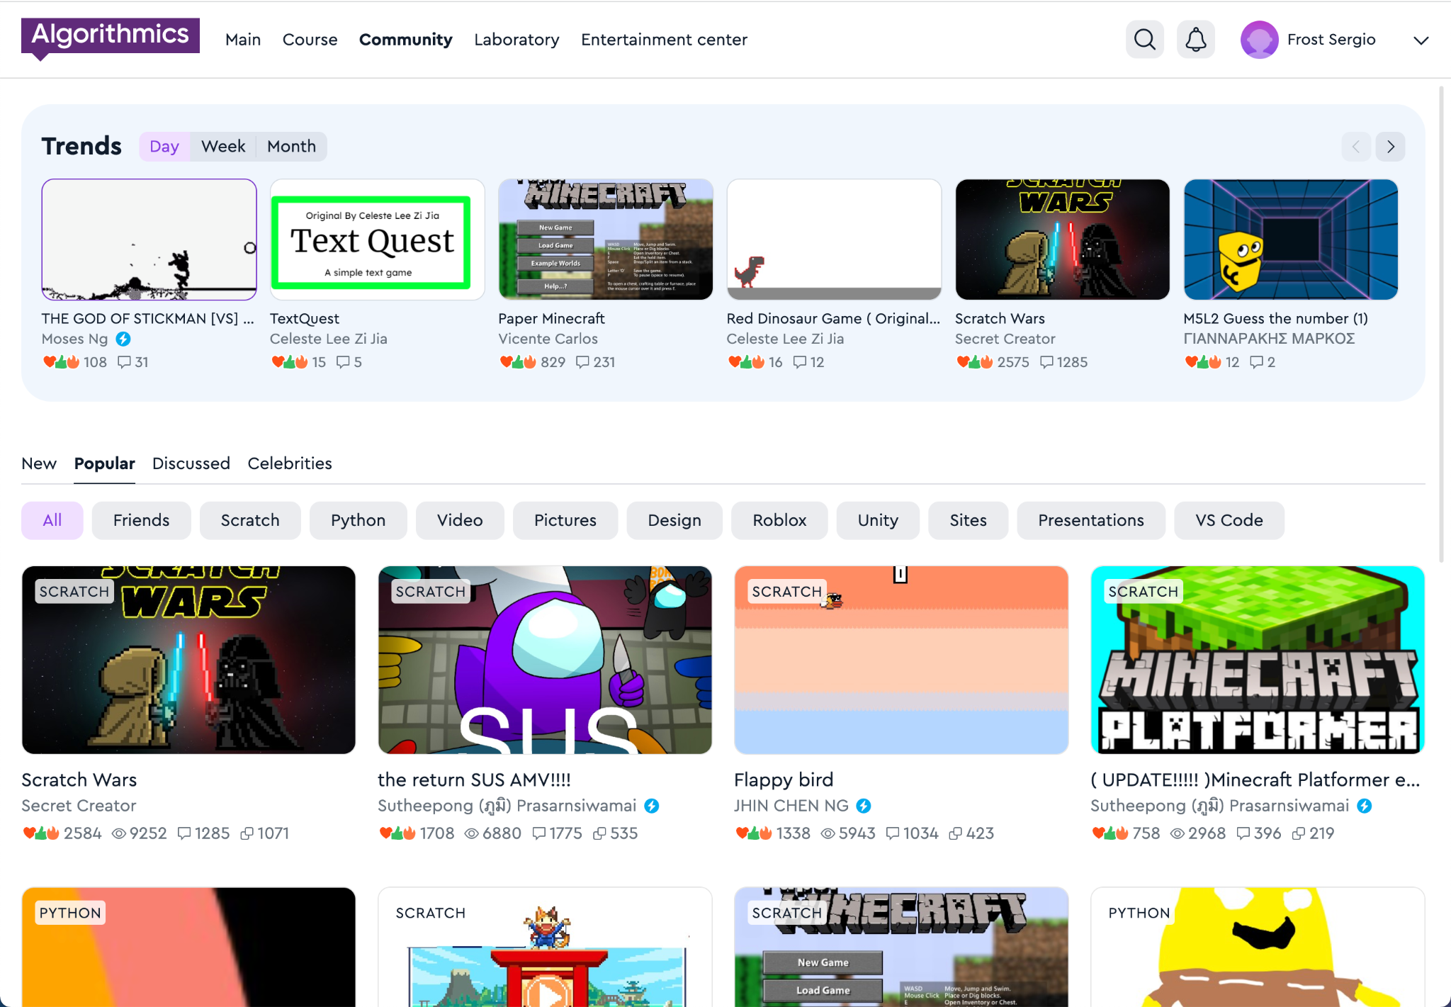
Hall of Fame
A space where our guys share projects, games, and ideas with each other.
In the Hall of Fame, the guys communicate and compete with each other
Hall of Fame

Slide 72
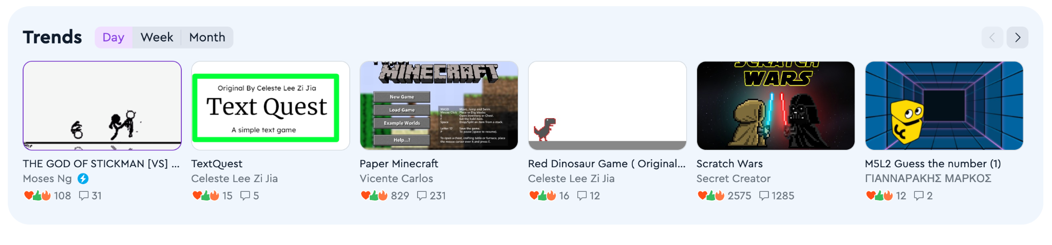
Trends
A block with new projects that are gaining popularity. The projects in this block help to understand what is happening in the Hall of Fame.
The trends reflect the projects that have the most likes and comments per day, week or month.
Hall of Fame

Slide 73
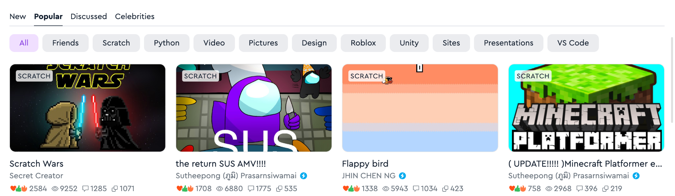
Viewing projects
Projects are displayed by newness, popularity and number of comments, and you can also view projects of "Celebrities", friends, and projects on individual subjects
Hall of Fame

Slide 74
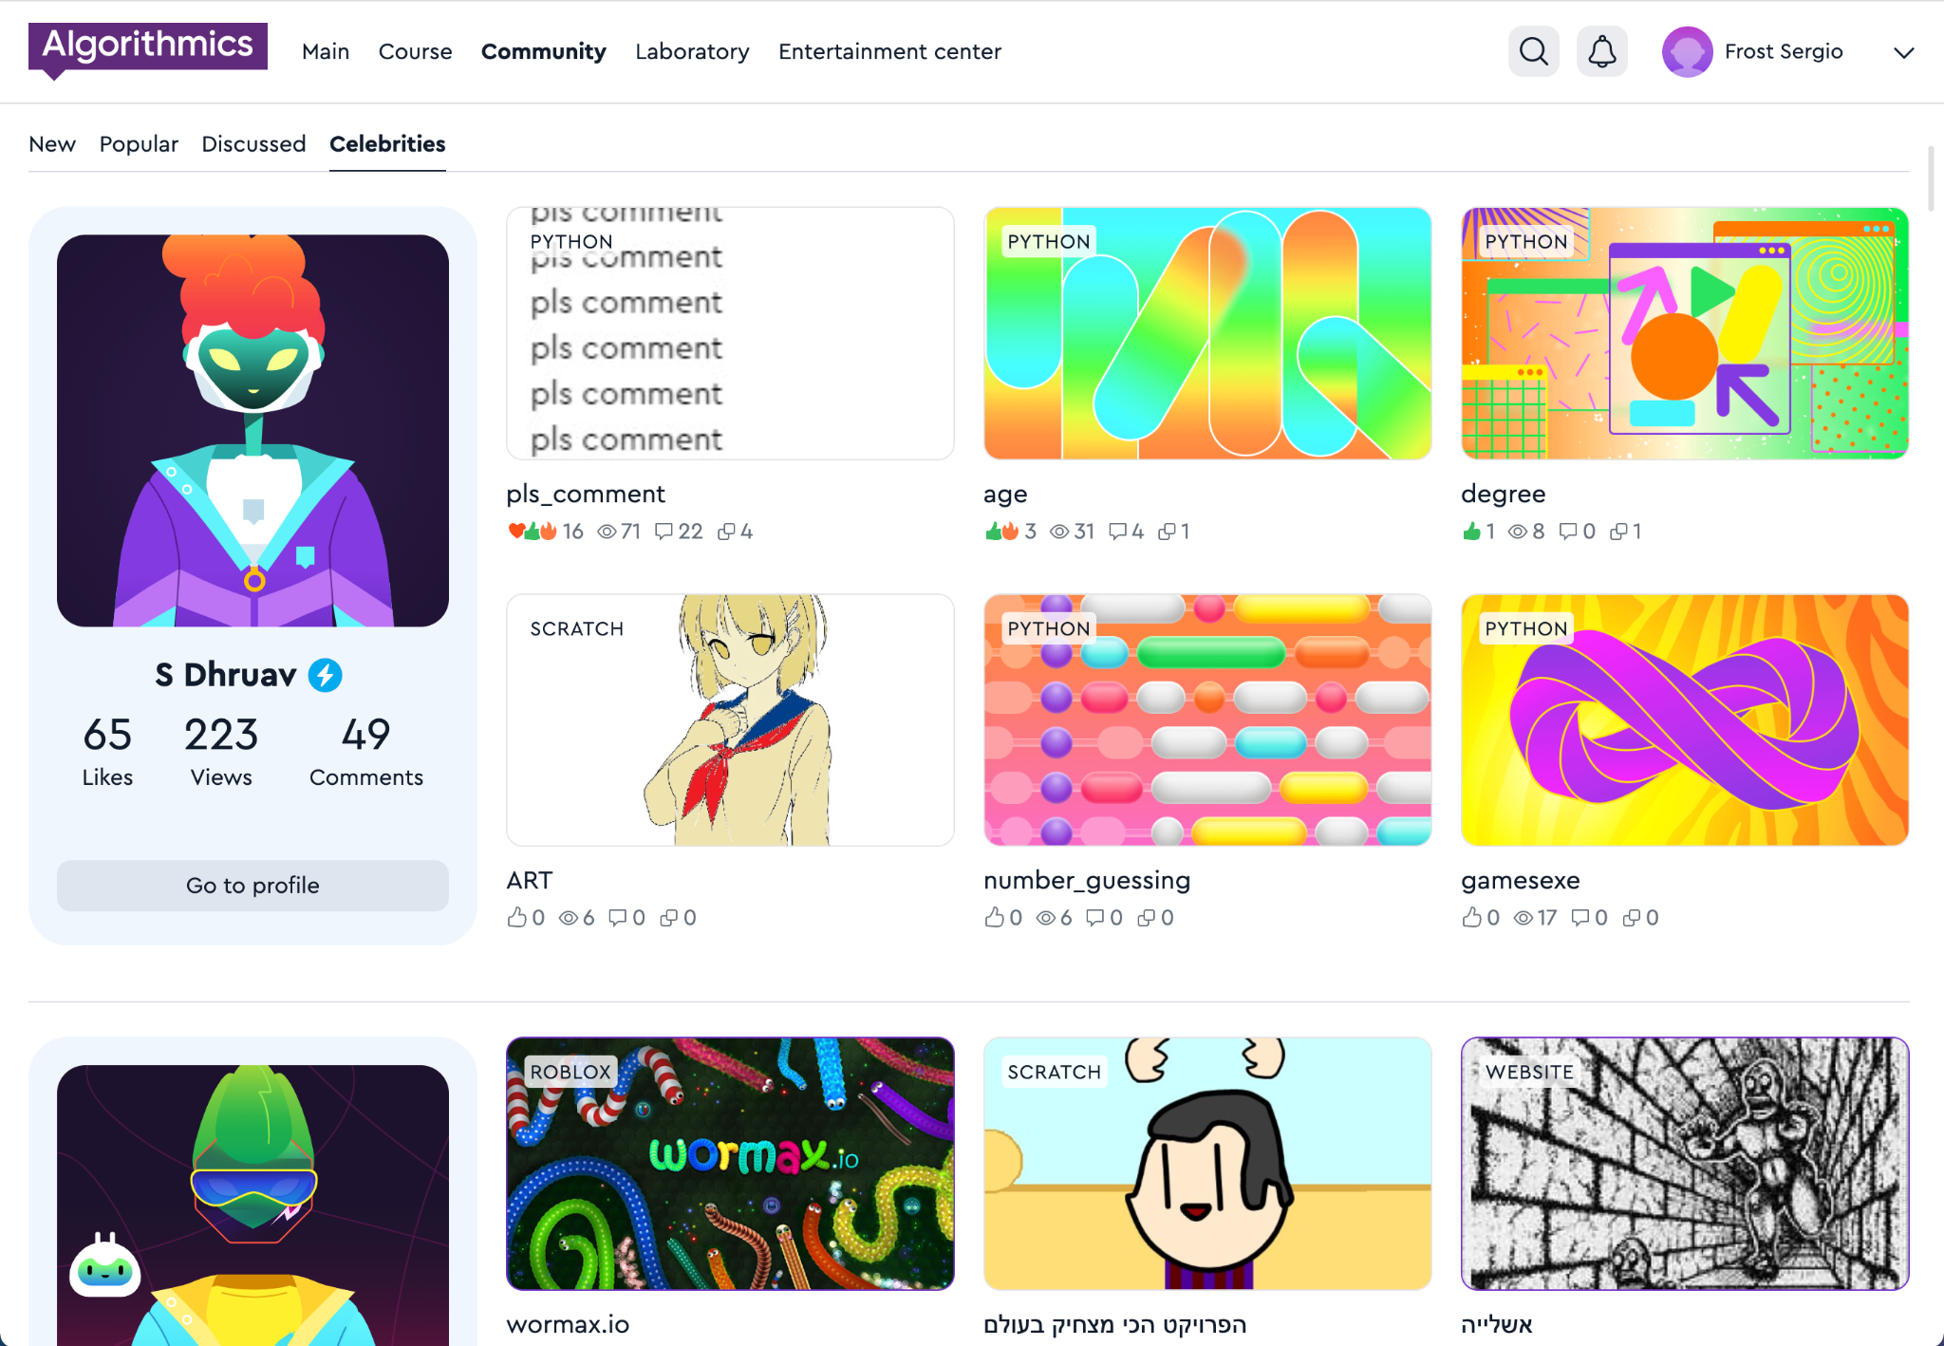

Celebrity
Students who make cool projects and win competitions receive a special status: "Celebrity".
A student who has received celebrity status receives a blue badge
Hall of Fame

Slide 75
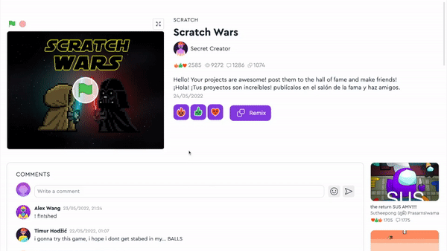
Projects
See the work of other students, play games.
Put reactions, share comments and discuss projects.
Hall of Fame

Slide 76
Hall of Fame rules
When you publish projects or write comments, make sure that you don't break the rules:
😇 | Politeness Do not scold or insult other students.
🤗 | Honesty Do not publish false information about events or people.
🕊 | Peace and friendship Don't add scenes of violence or crimes to your projects.
🚫 | No prohibited materials Do not publish indecent pictures, videos, text, etc.
For violating the rules, your access to the Hall of Fame will be restricted:
— for one week for the first violation,
— for two weeks for the second violation,
— for one month for the third and next violations, and we will also write to parents
Hall of Fame

Slide 77
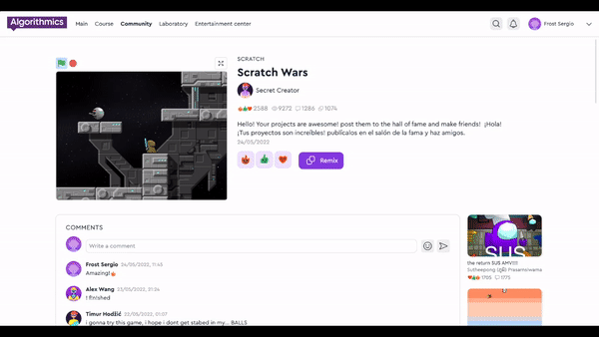

Full-screen project
It's easier to interact with projects if they are open in full screen mode.
To open the project, click on the arrow icon
Hall of Fame

Slide 78
Messages from the teacher and projects of classmates
My class

Slide 79
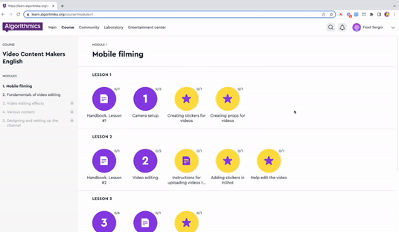
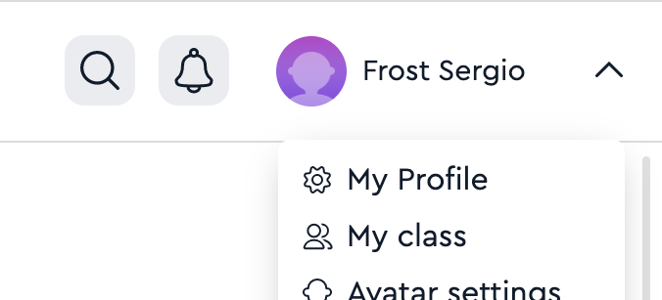
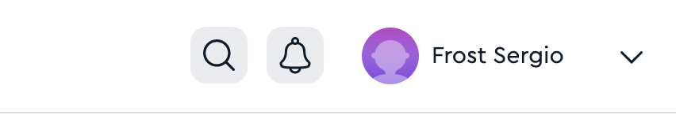
My class
The space in your classroom where you can publish and discuss projects with classmates, and view messages from the teacher.
1. Click on your name in the upper right corner
2. Click on the item
"My class"
Hall of Fame

Slide 80
Storing and viewing your projects
Laboratory

Slide 81
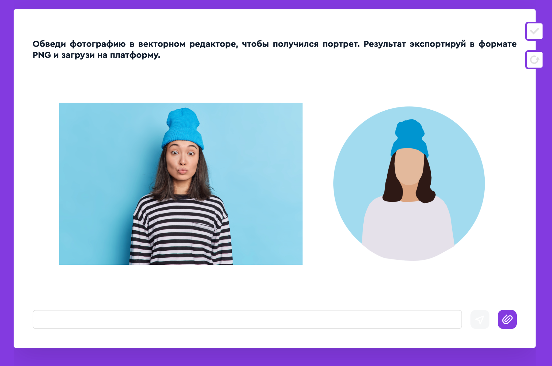
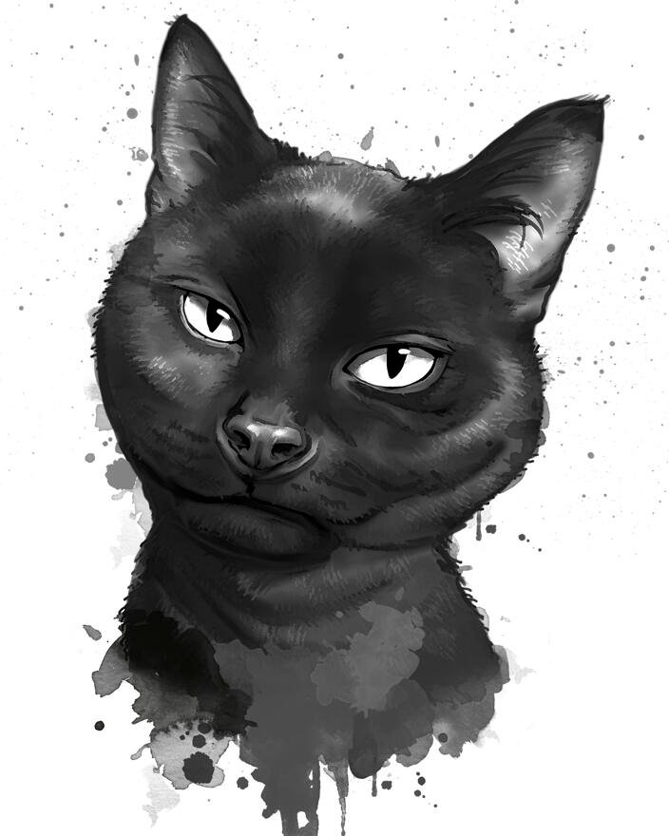
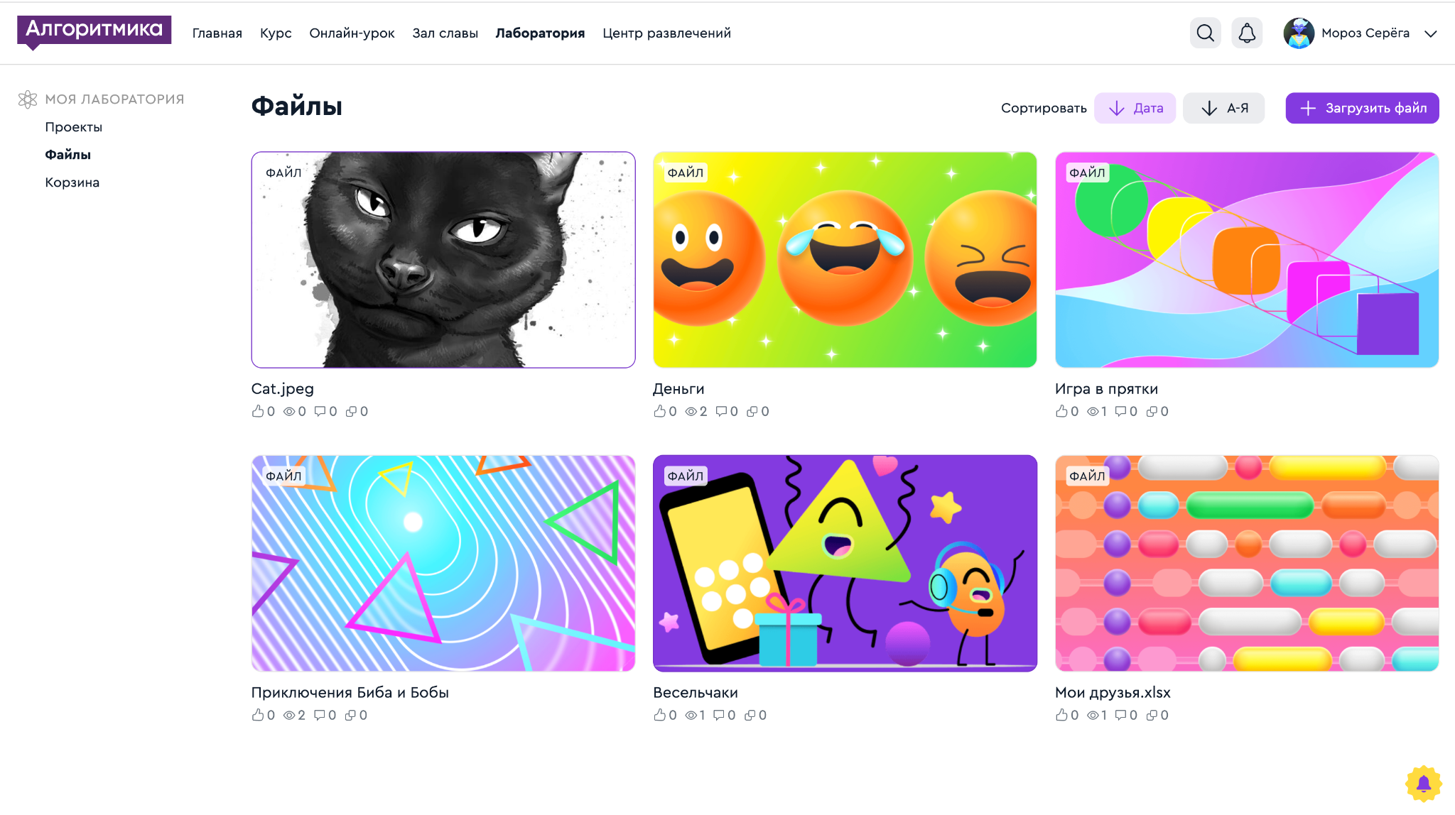
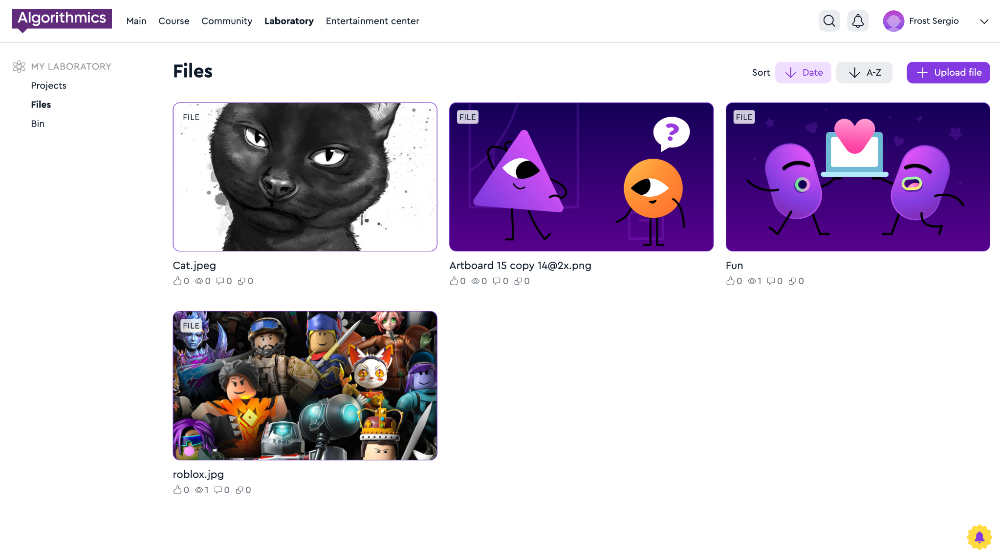
Your solutions are stored in the Lab
The files that you uploaded to the task on the platform go to the "Lab" on the "Files" tab.
Hall of Fame

Slide 82
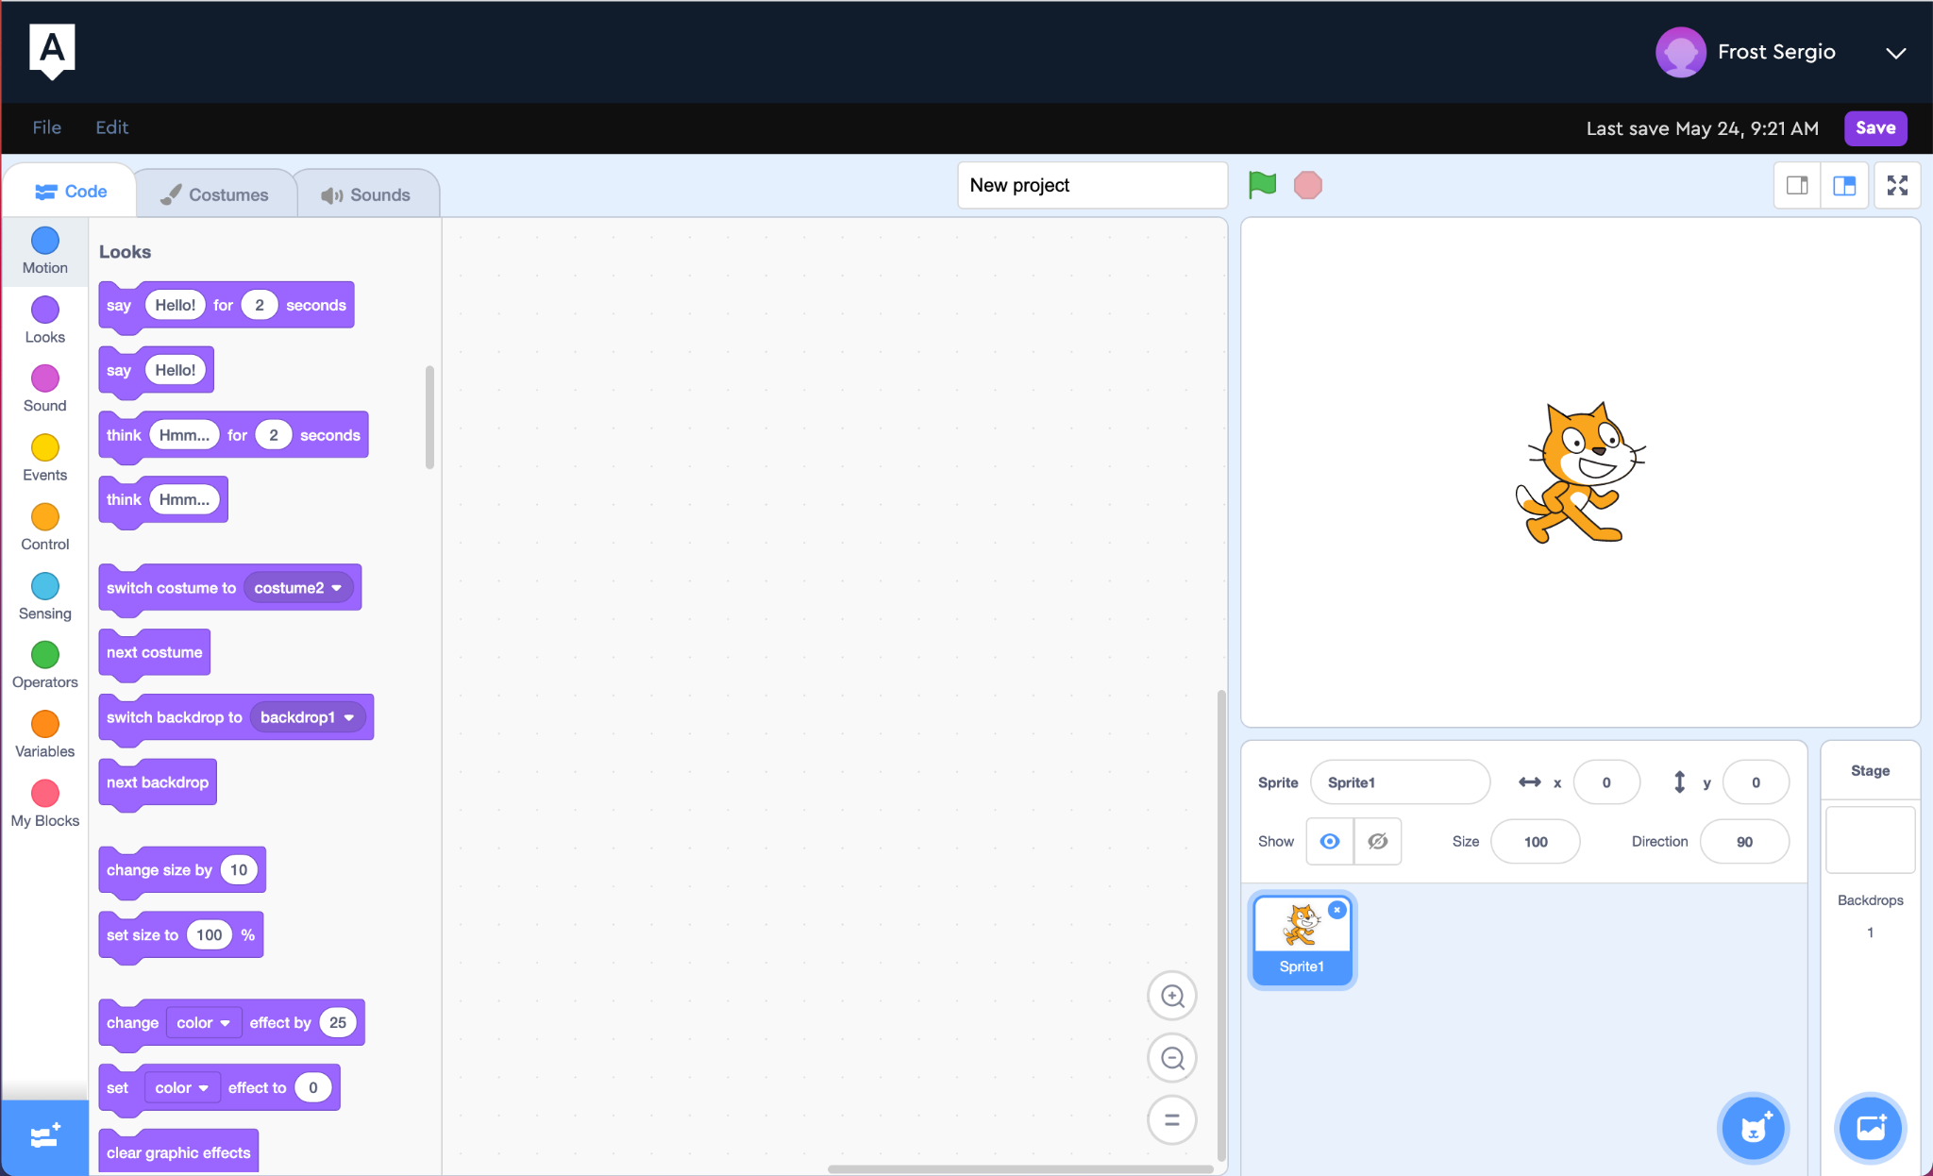
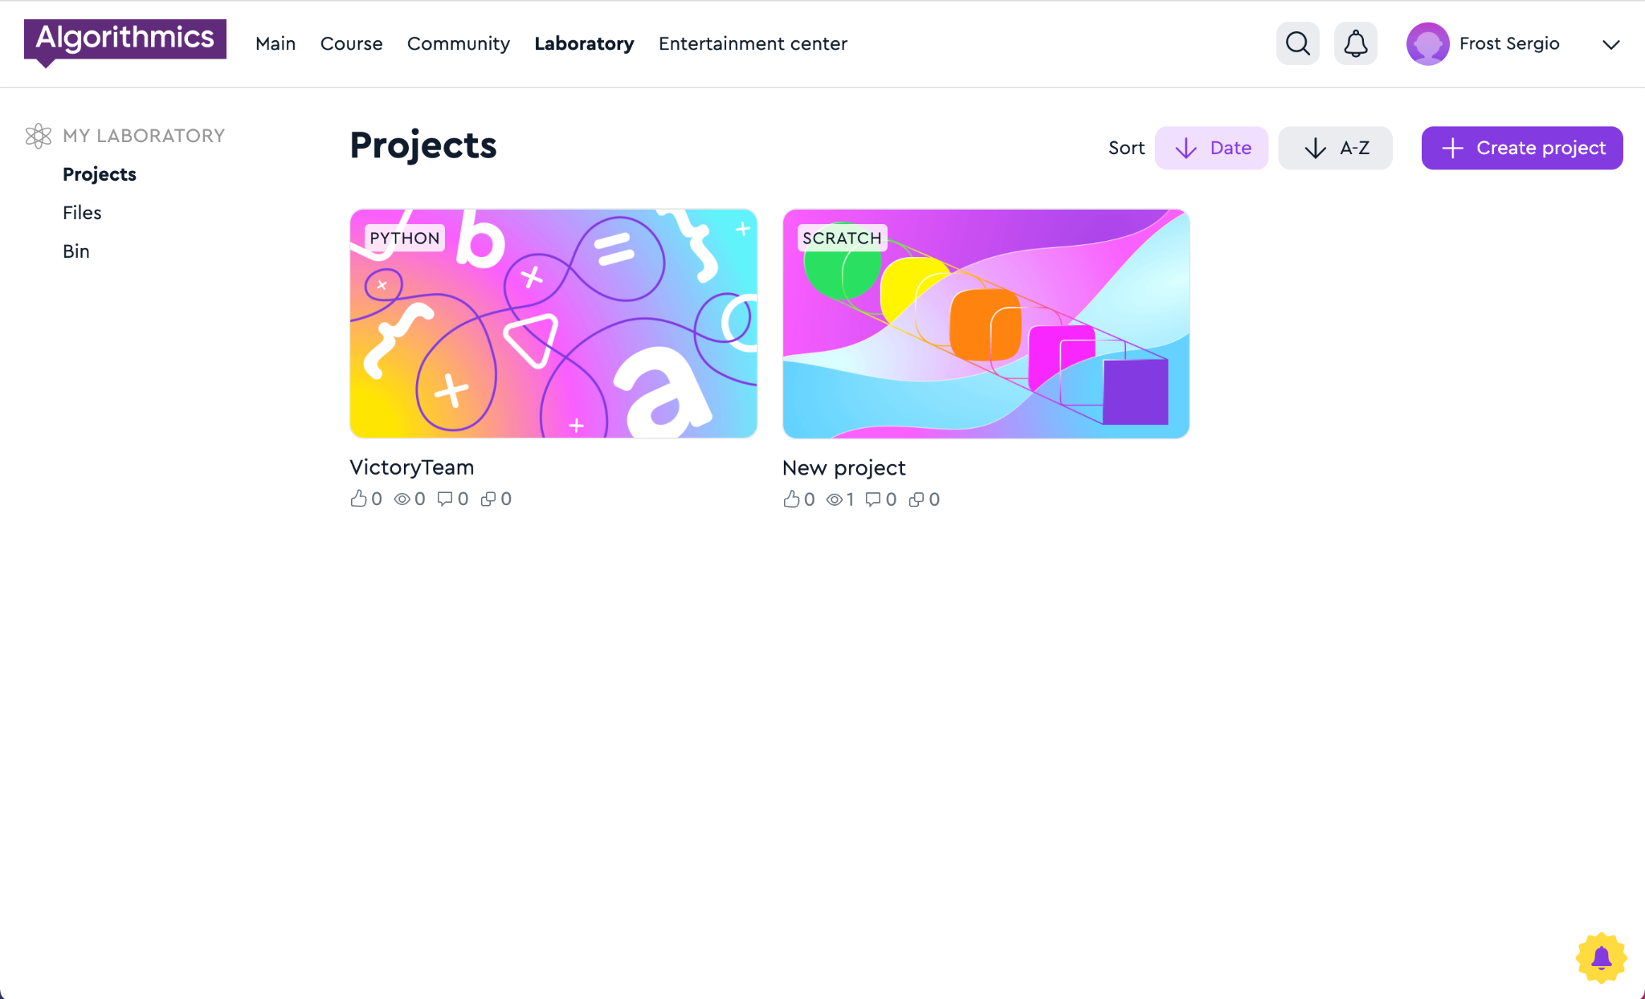
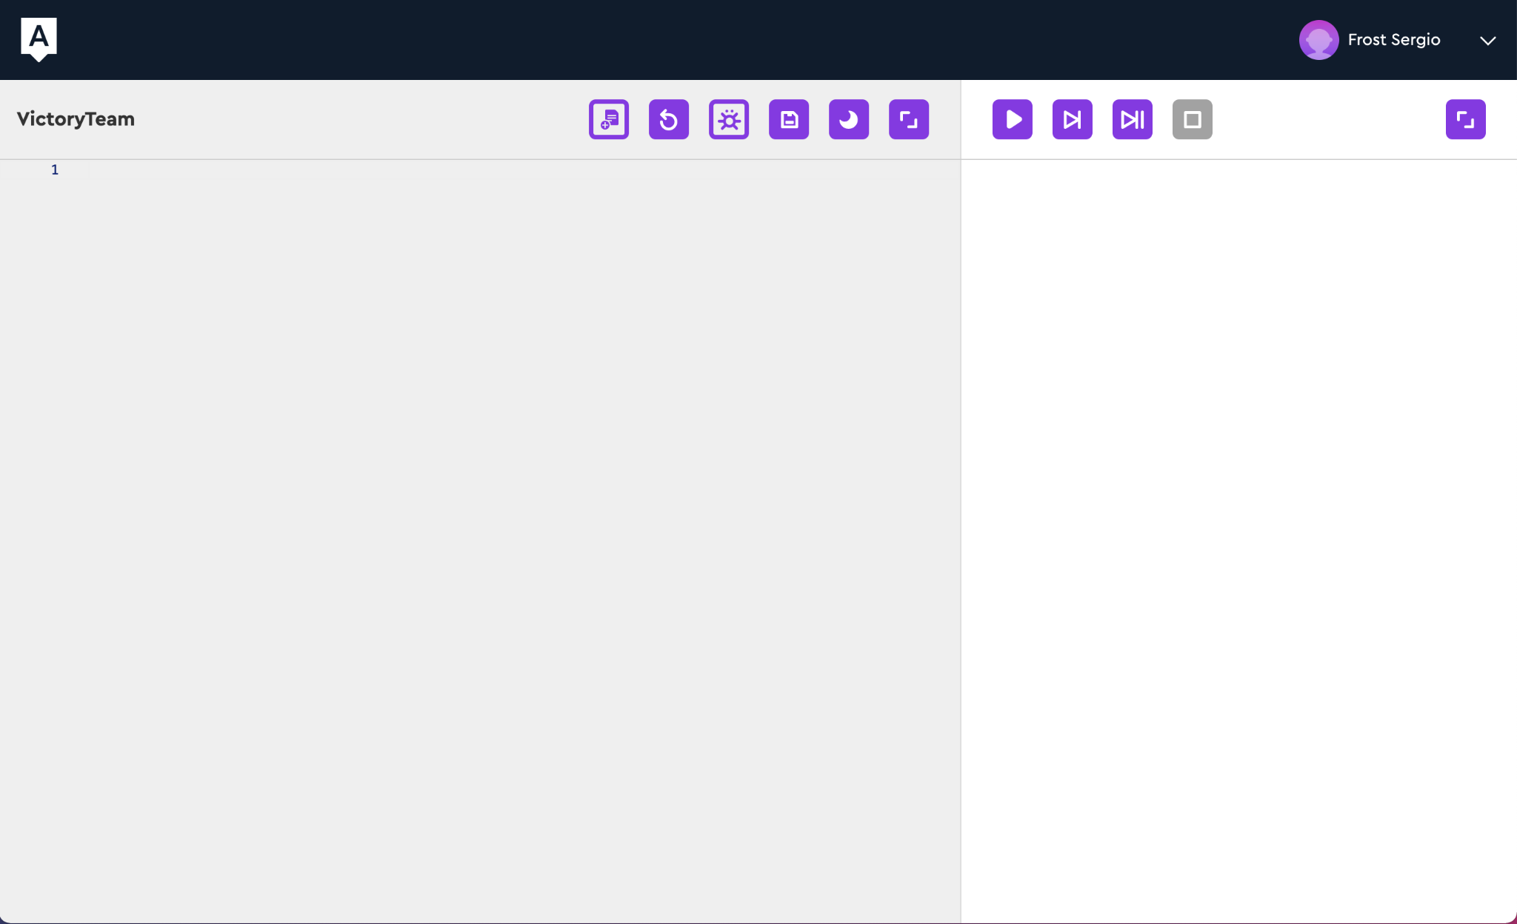
Your solutions are stored in the Lab
Scratch and Python solutions go to the "Lab" on the "Projects" tab immediately after saving.
Hall of Fame

Slide 83
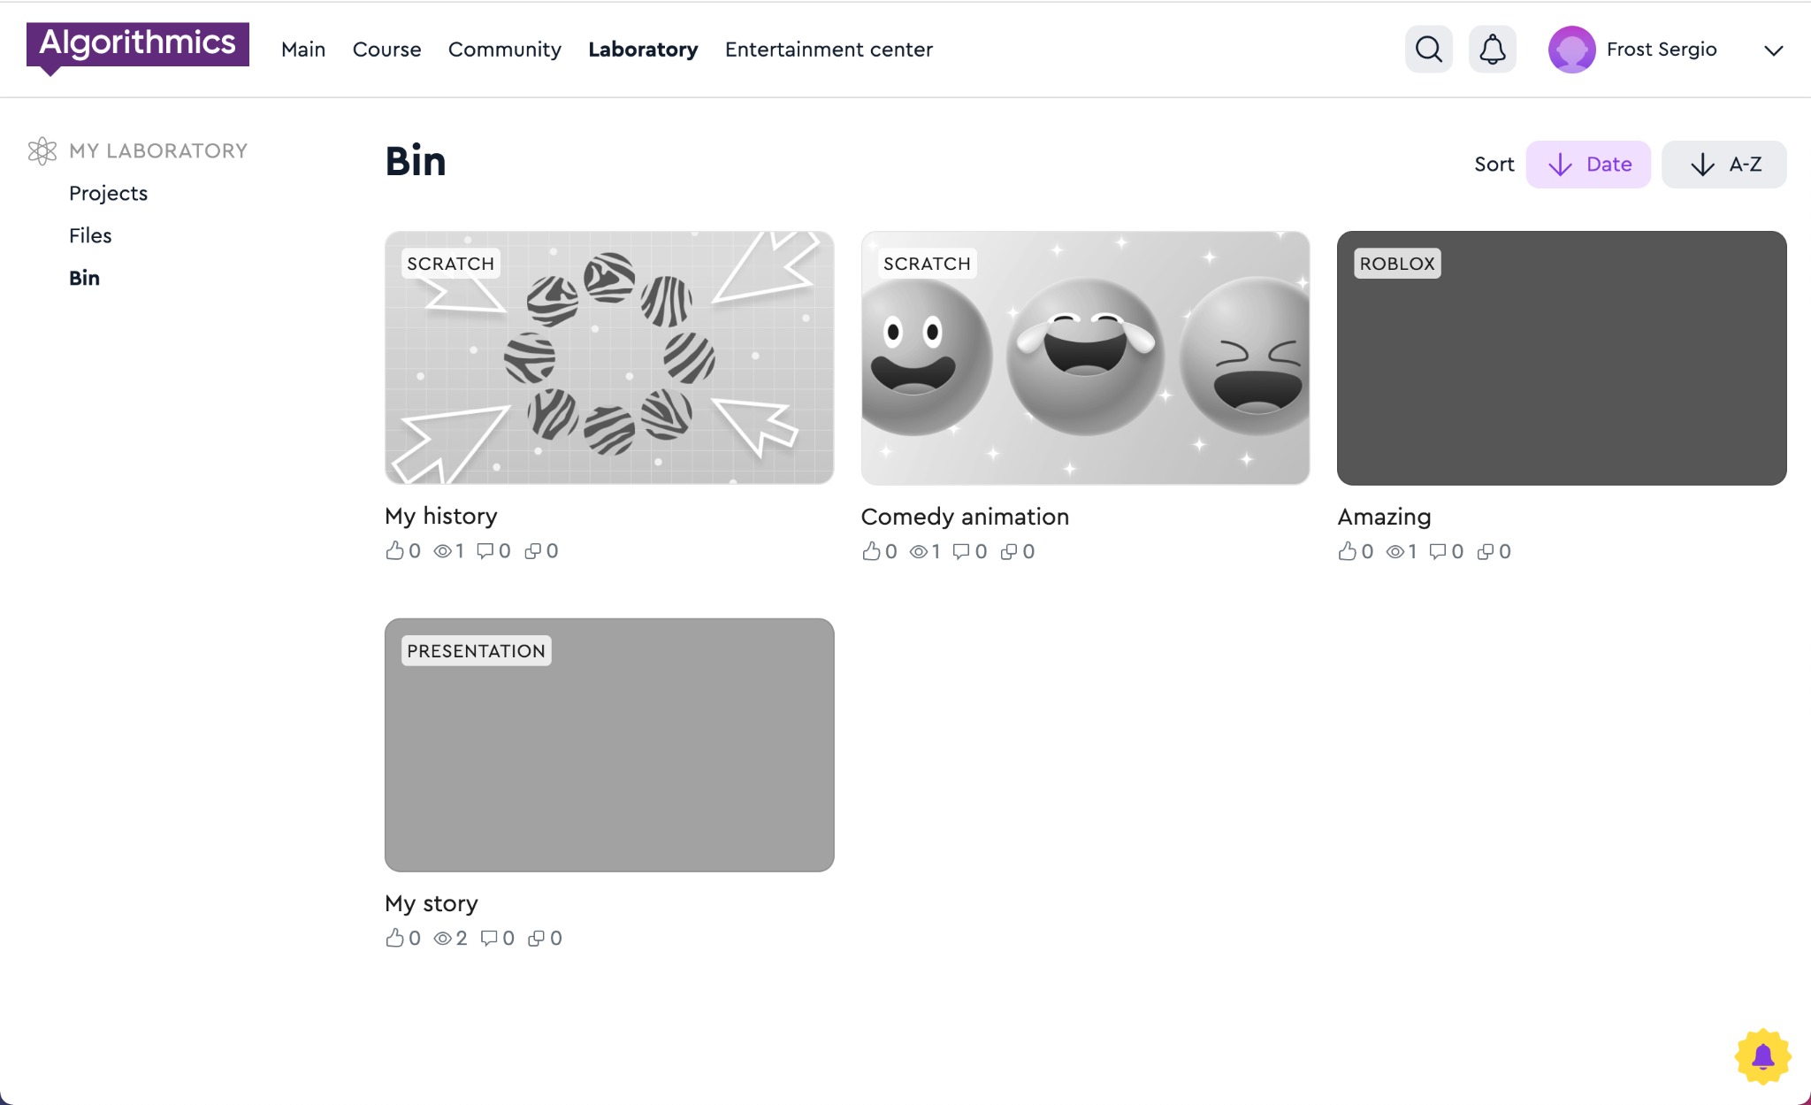
Deleted projects end up in the "Trash"
Hall of Fame

Slide 84
Publishing Python projects
Laboratory

Slide 85
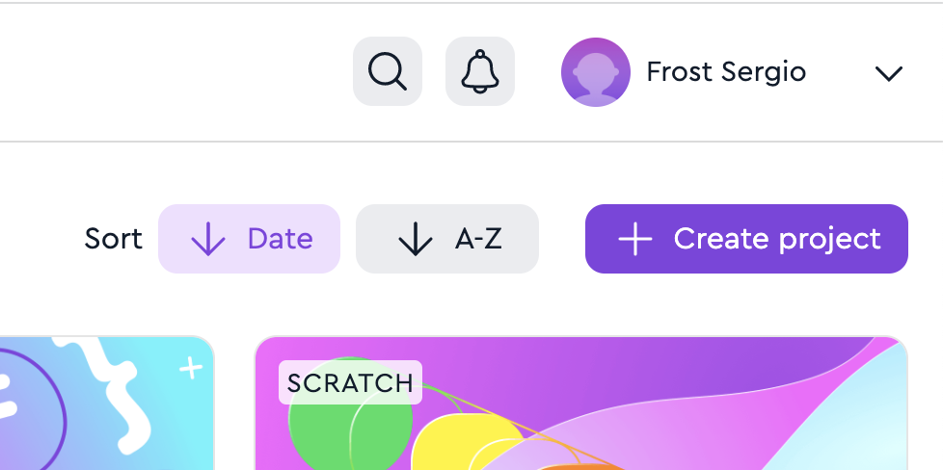
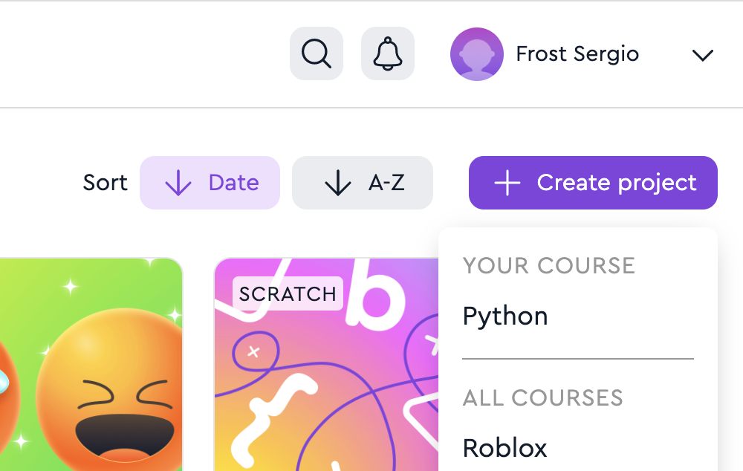
Create a project in the Lab
1. Go to the "Laboratory" page
2. Click on the button "+ Create project" → Python
Laboratory

Slide 86
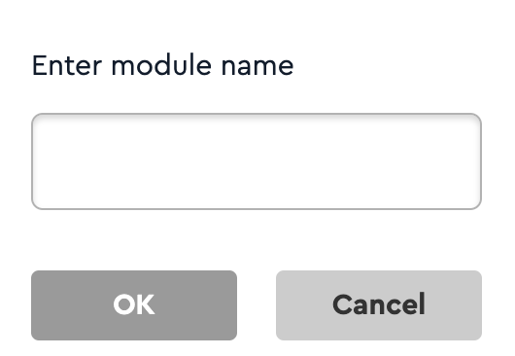
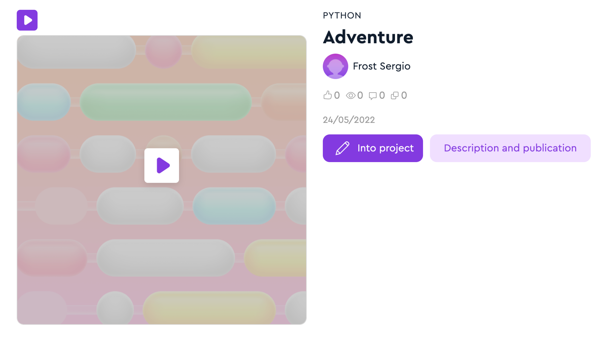
Add a name
3. Enter the project name Use only Latin letters, numbers and the sign "_" The name should not be the same as other names of projects on Python
4. Click "Description and publication"
Laboratory

Slide 87
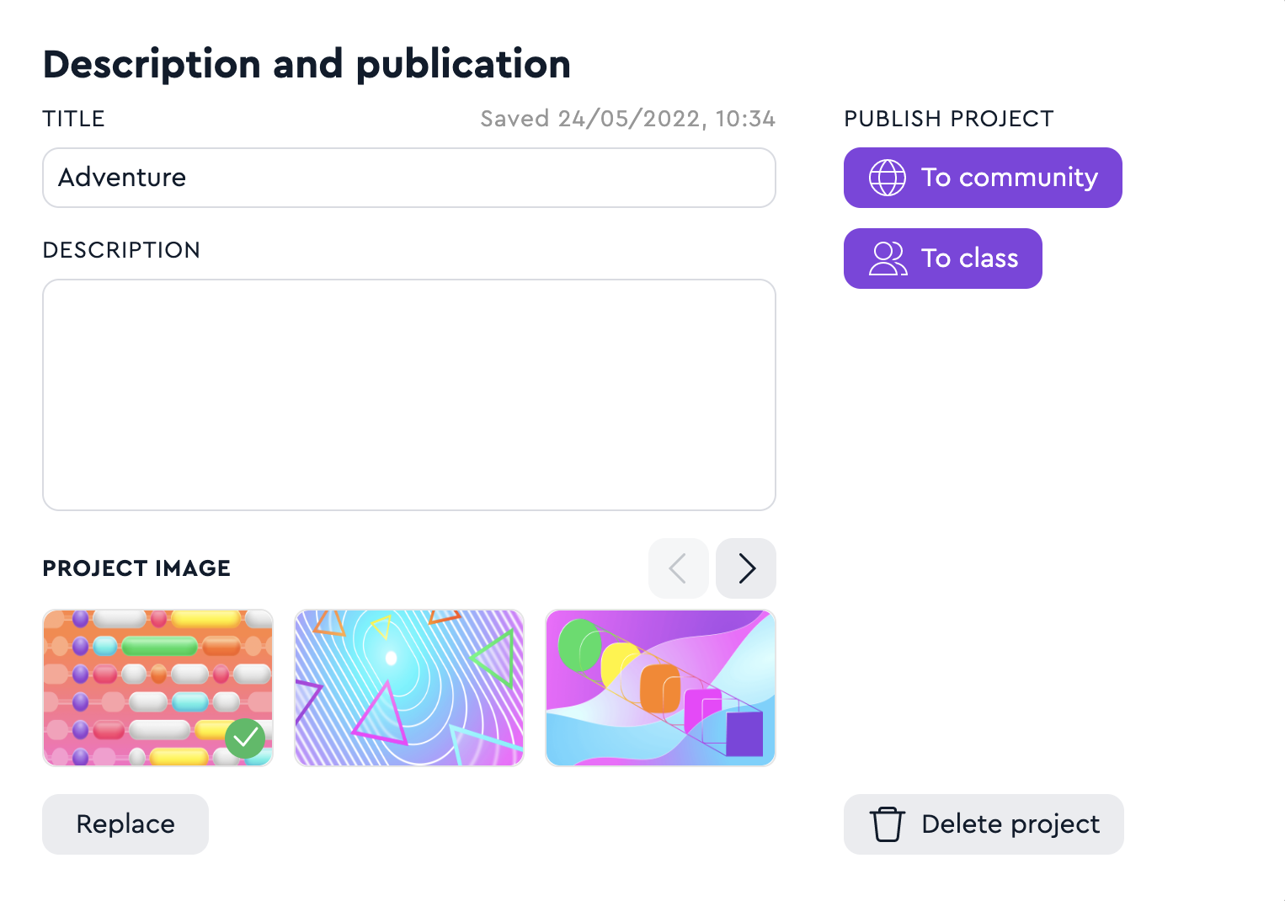
Enter a description and publish
5. Enter the name and description
6. Select and upload an image
7. Publish your project to the Hall of Fame or Class
Laboratory

